Slide 1
Alabama Mandatory Training Library Overview
Tricia Banks Sr. Director Improvement Services tricia.banks@cognia.org
Auburn Keaveney Director Improvement Services auburn.keaveney@cognia.org
© 2019 Cognia, Inc.

Slide 2
Agenda
Cognia Learning Community overview
Collaboration and creation of the Mandatory Training Library
Demonstration – Accessing the library/labs
Virtual visibility – Data collection
Next steps

Slide 3
Activities in Alabama
Cognia Continuous Improvement Activities in Alabama
ACIP* | Partnership Meetings | Technology Survey*
Assessment Reviews | Professional Development | Thought Leadership
Compliance Monitoring* | Teacher Observation Tool* | Virtual Desktop Reviews*
Custom Diagnostics*
*Activity uses myJourney portal in the Cognia Improvement Platform. All public schools in the state have full access to myJourney portal in the Cognia Improvement Platform.

Slide 4
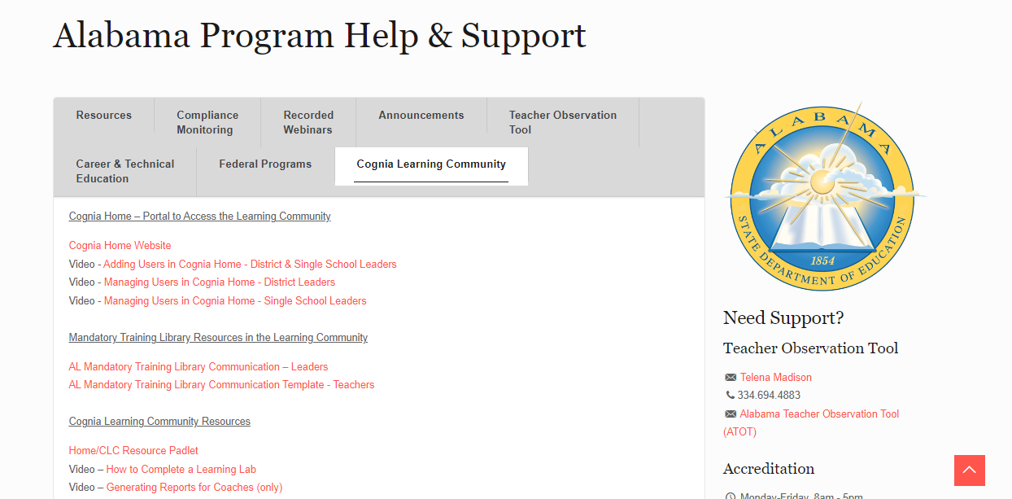
Partnership resource page
https://alsde.onlinehelp.cognia.org
Notes:
Paste in chat: https://alsde.onlinehelp.cognia.org/

Slide 5
Explore the Cognia Learning Community

Slide 6
What is the Learning Community?
Proprietary platform
Professional learning content
Educator communities
Virtual visibility

Slide 7
Learning Lab
Spark
Reflect
Inspiration
Curiosity
Current practice
Opportunity
Grow
Tinker
Reflection
Next steps
Preparation
Interaction
Source: The Learning Innovation Catalyst (LINC)

Slide 8
Learning Community Features
Unlimited users
Core Library (25 Labs)
Early Learning Library (15+ Labs)
Alabama Mandatory Training Library
Create your own content
AL Leader PLUs
Instructional Leadership
ATOT

Slide 9
Additional content*
Accelerating Student Learning (18 labs)
Assessment Design (19 labs)
Blended Learning (25 labs)
Building Early Literacy (15+ labs)
Differentiation that Works (20+ labs)
Personalizing Instruction for All Learners (28 labs)
Project-Based Learning (11 labs)
Strategic Thinking and Planning (17 labs)
Teacher Observation Tool (14 labs)
*Access the Padlet for information about additional content for purchase

Slide 10
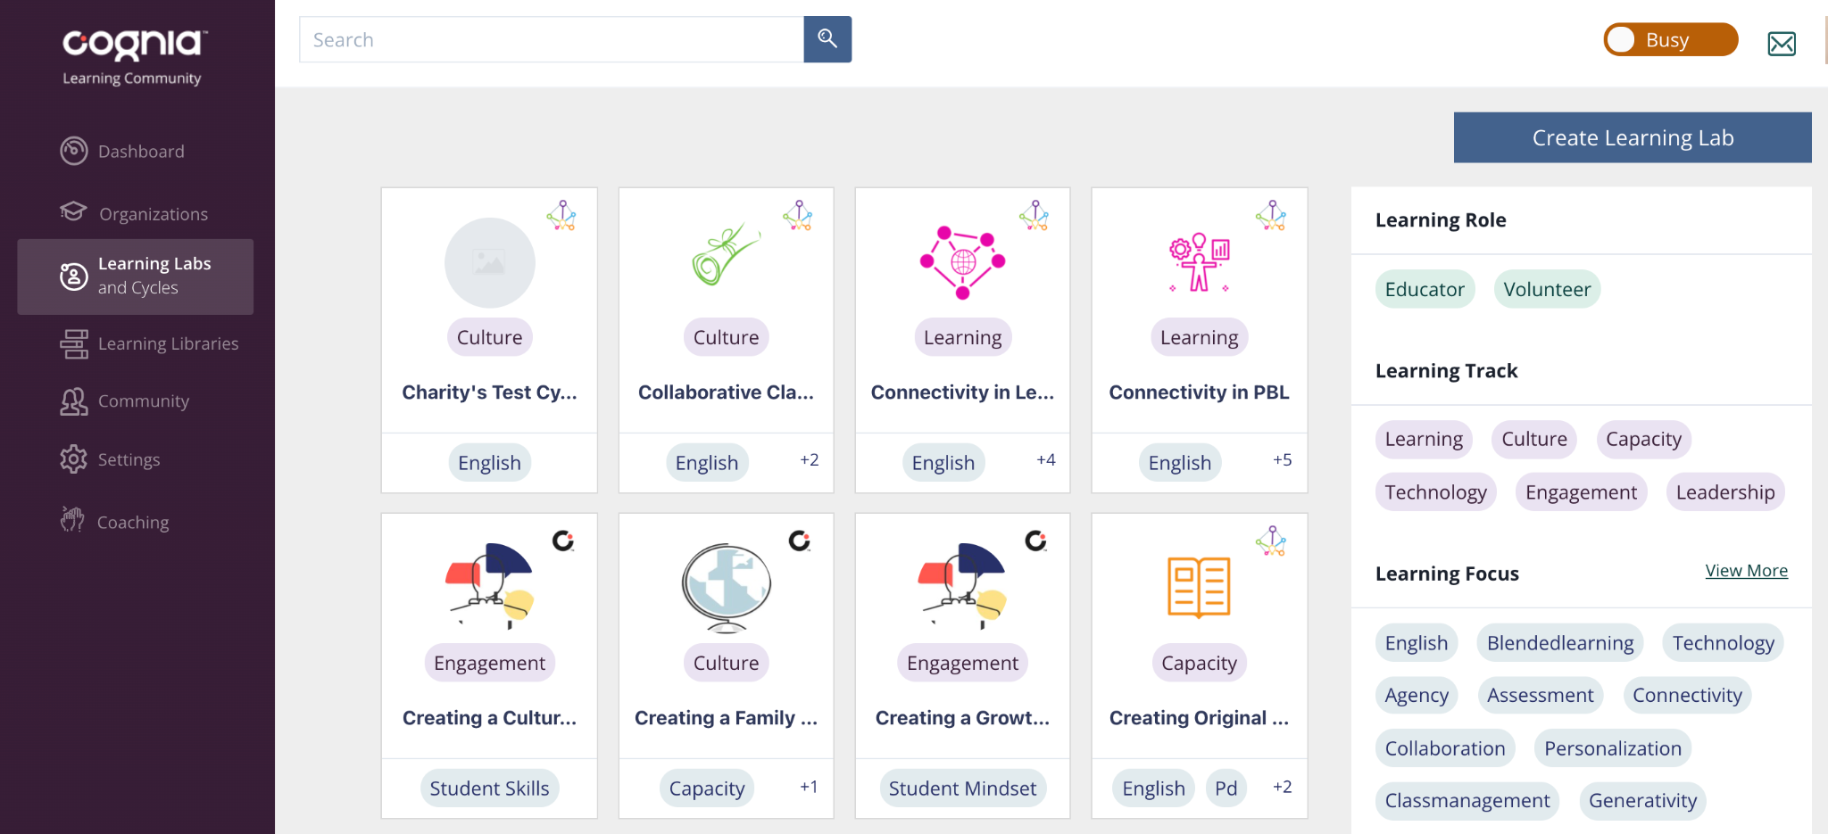
Create your own Learning Labs
Notes:
Say: One of the unique features is the ability for you, the school or district, to create content using the Spark, Reflect, Tinker, Grow format to deliver professional learning to your staff based on initiatives relevant to your continuous improvement work.

Slide 11
Mandatory training library
Notes:
Facilitator notes:
Highlight low-stakes, high-yield outcome for educators to acclimate to the design of Learning Labs.

Slide 12
Mandatory training labs available
Notes:
Facilitator notes:
Highlight low-stakes, high-yield outcome for educators to acclimate to the design of Learning Labs.

Slide 13
Questions?
Learn more at Cognia.org

Slide 14
Mandatory Training Lab Demo
Navigating to the Learning Community and Completing the Learning Labs
Notes:
10 – 15 minutes
SAY:
Head to Cognia Home and then to Learning Community.

Slide 15
Next Steps

Slide 16
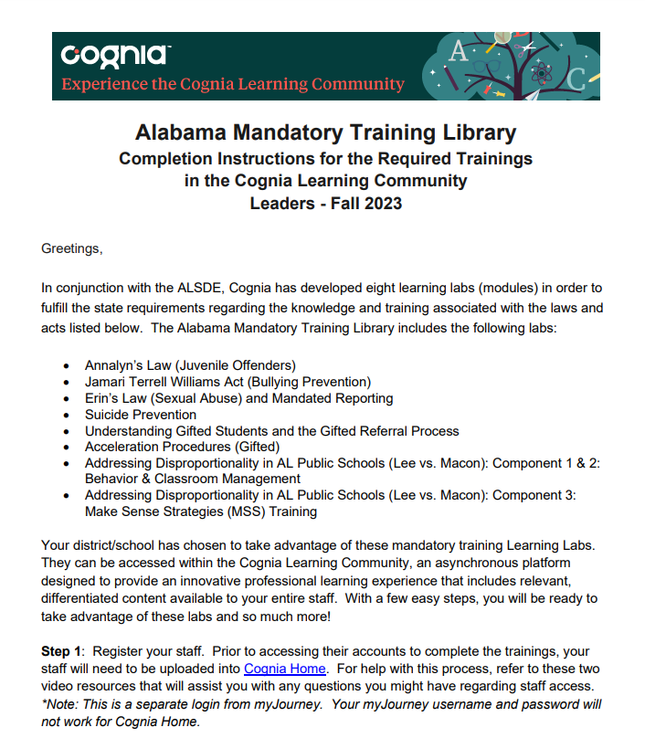
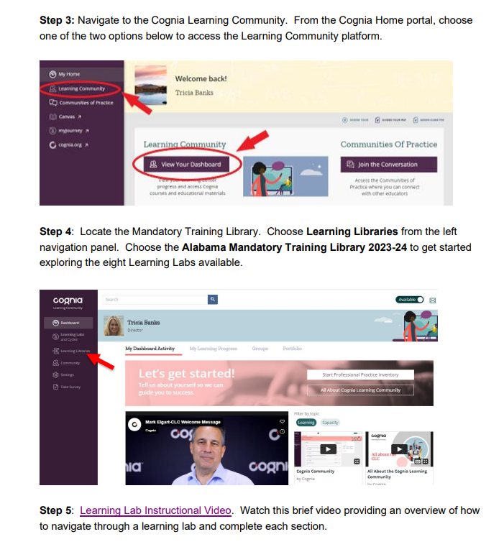
Step 1: District emails school leaders

Slide 17
Step 2: Leaders email teachers

Slide 18
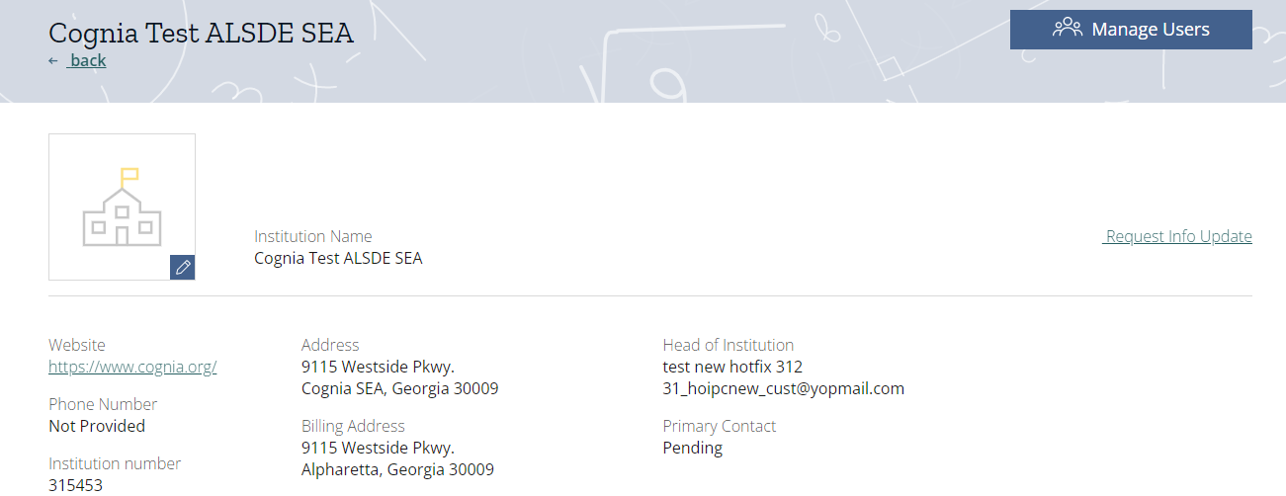
Step 3: NEW to the CLC upload teachers

Slide 19
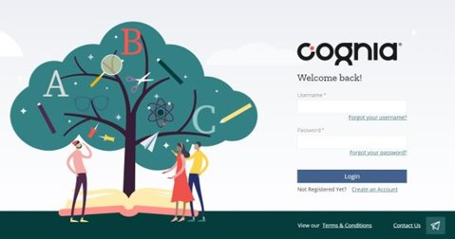
Step 3: Cognia Home – Returning Users Sequence
Assign a designee
Determine due date for personnel changes
Ensure designee has Admin access
Designee trains on tutorial videos provided
Designee disables staff who left, then adds new staff

Slide 20
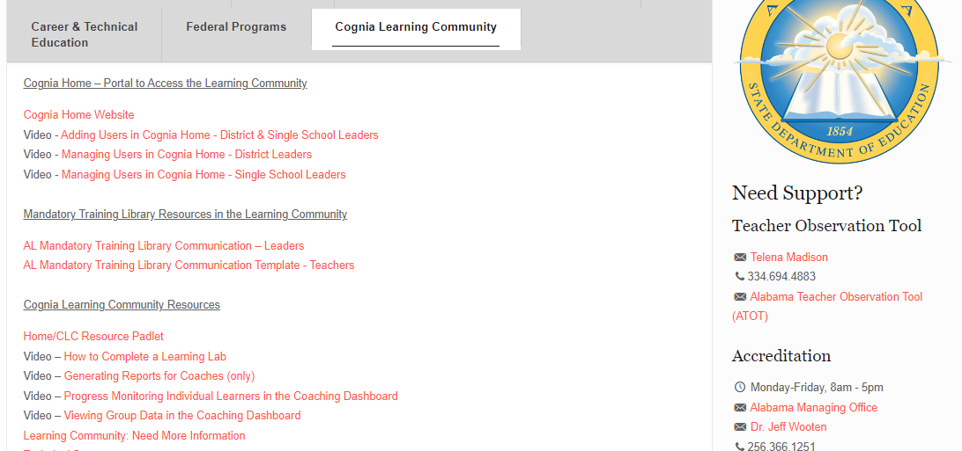
Step 4: Monitor Progress & Collect Data
Notes:
Note: Tutorial videos for all functions and features are available in the AL Partnership webpage.

Slide 21
Thank you offer from Cognia
Complete the form to have a Cognia representative reach out to you to:
Engage in a data analysis review of ATOT data
Access to a Teacher Observation Tool Learning Lab based on identified need with ATOT data
Notes:
Will also be receiving this in follow-up email after today's webinar.

Slide 22
Contact Us!
Alabama State Directors
Jeff Wooten: jeff.wooten@cognia.org
Jeff Langham: jeff.langham@cognia.org
Learning Community Team
Tricia Banks: tricia.banks@cognia.org
Auburn Keaveney: auburn.keaveney@cognia.org
Technical Support
Client Care: clientcare@cognia.org

Slide 23
Questions?
Learn more at Cognia.org

Slide 24
Stay Connected.
Learn more at cognia.org

