Slide 1

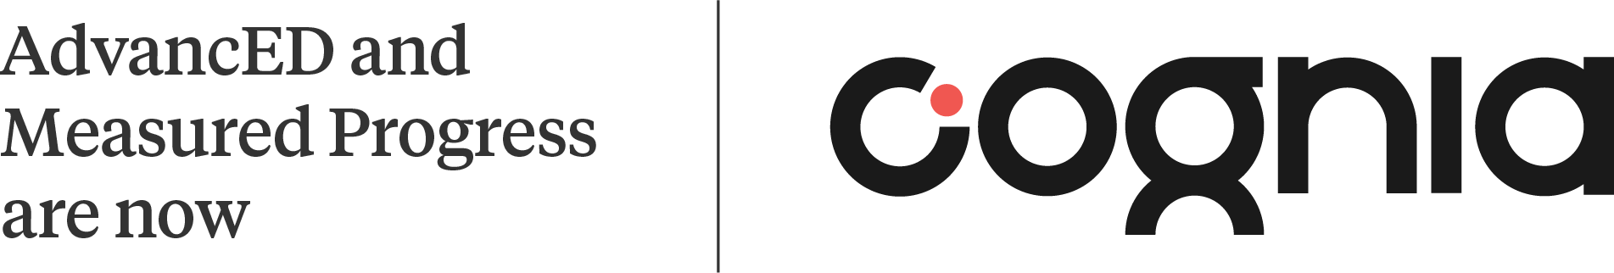
2022-2023 21st Century Community Learning Center School-Level Diagnostic
Alabama Community Education Association Conference 2023
Notes:
ALSDE and Cognia are committed
to assisting Alabama educators and students on their improvement journey.

Slide 2
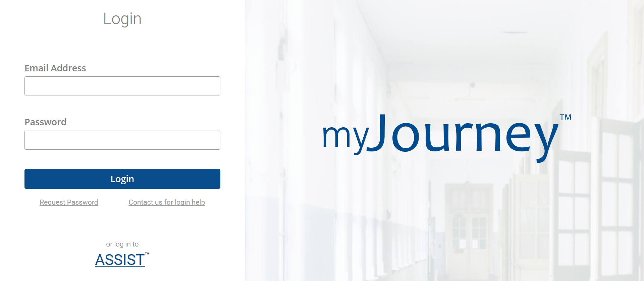
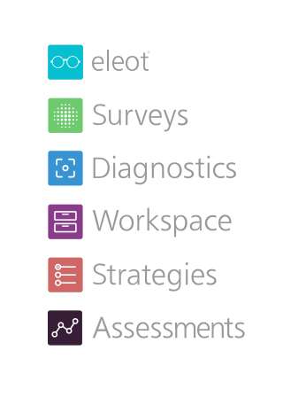

Cognia Improvement Platform
Notes:
This slide has animation.
Enter your credentials here. Log in with your email address and password. If you do not have a password, click Request Password and enter the email address associated with the Cognia account to request a password.
The Cognia Improvement Platform includes this suite of tools. Aligned with Cognia’s Continuous Improvement System, this is a state-of-the-art productivity platform that helps institutions with their continuous improvement efforts by empowering education institutions to make sense of and use their data to support their continuous improvement journey. [Press Enter]
Once users click “log in” from the Cognia website home page, users enter email and password into the myJourney landing page shown here to access the tools found within the Cognia Improvement Platform.
Today we will explore how each of these tools can support the Continuous Improvement Process.
The tools within the Cognia Improvement Platform are:
eleot (Effective Learning Environments Observations Tool) – used to conduct meaningful observations focused on student engagement
Surveys – used to build and administer customized stakeholder surveys and inventories to collect and report actionable data
Diagnostics – a self-assessment tool used to uncover the root causes of issues and evaluate the overall effectiveness of improvement efforts
Workspace – a space to assemble and manage collaborative teams for the Improvement Journey and Engagement Reviews
Strategies –a tool connected to the Strategic Planning Process and used to identify goals, define and monitor strategies, and allocate resources to create workable improvement plans
And, assessments – a set of formative resources that elicit evidence of student understanding to inform teaching and learning in real-time
We are going to explore how some of these tools can support your data today.

Slide 3

Accessing eProve Tools
Use Chrome Browser!!!
Notes:
Cognia’s tools work best with the Chrome browser.
Ensure if a user responds for a notification email, that they are using Chrome as the default browser.

Slide 4

CLC
eProve

Slide 5
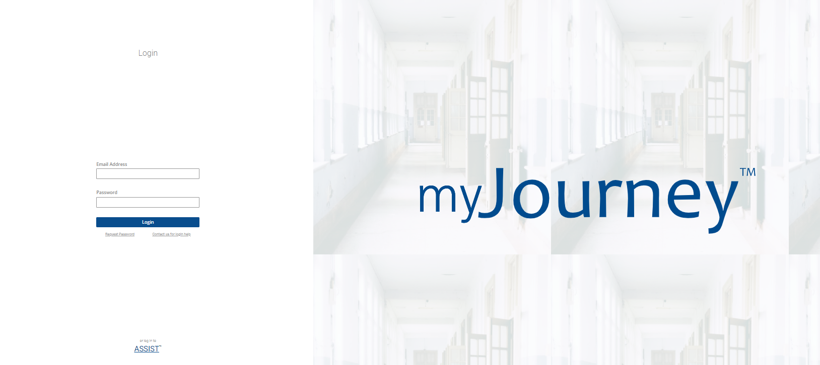
Enter your email address and your password

Slide 6
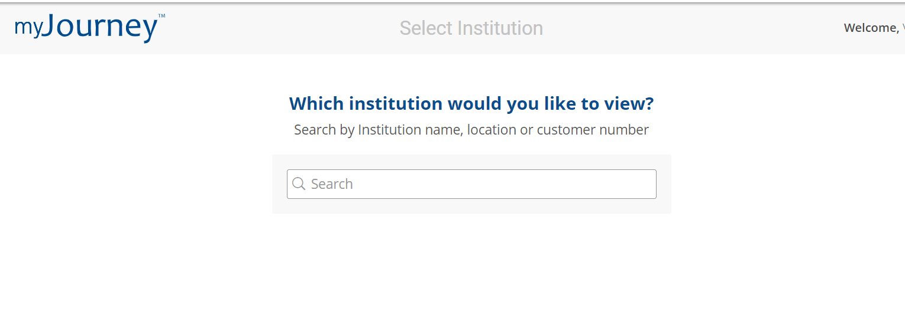
Search or choose your LEA in the dropdown menu

Slide 7
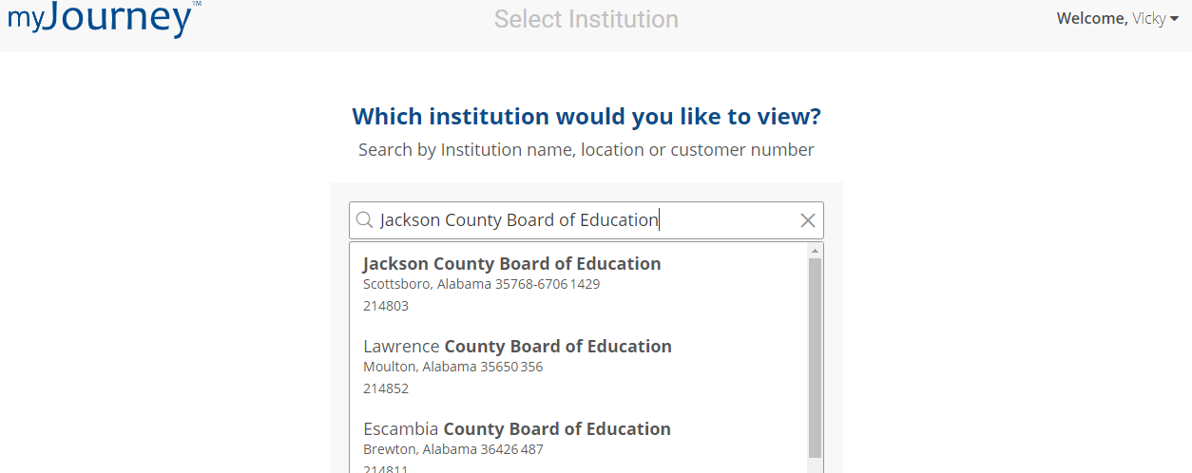

Access the Diagnostics
If you have permissions for more than one institution, select the desired institution from the list.
For 22-23 a user must choose the institution which he/she wants to complete the diagnostic
Search engine has a narrow focus.
Use the exact name that was used in your grant application approval documentation
Notes:
If you have permissions for more than one institution, select the desired school/district from the list.

Slide 8


Diagnostics for
Institutions
Notes:
SAY:
Now, let’s take a quick look at Diagnostics.
You and your team are the experts about your school and system. Our standards guide you to identify areas of strength and opportunities to elevate the quality of your school.
Diagnostics (in person presentation)
Engage in a brief Demo of survey. (Time permitting)

Slide 9
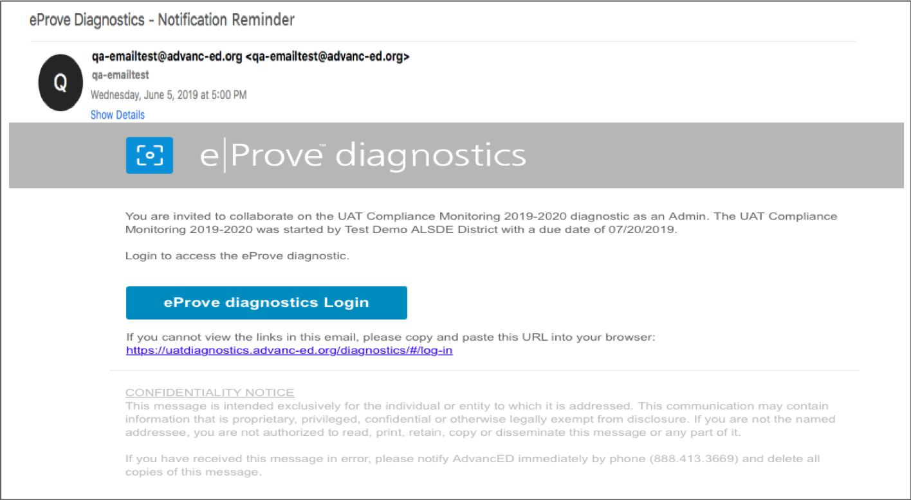
How to Access: Notification
The district Head of Institution, or HOI, and/or Primary Contact, or. PC, listed in eProve will receive the notification email that is generated when the ALSDE administrator publishes the Diagnostic for the 2022-2023 21st Century Community Learning Center School-Level Diagnostic administration.
Must accept the email notification in order to access Diagnostic.
Email notifications can be resent by administrator.
Ensure HOI and PC are updated with Cognia
Additional Users/Admins may be added in user management by the HOI of the institution or Cognia
Notes:
The district Head of Institution, or HOI, (traditionally the superintendent) and Primary Contact, or. PC (someone designated by the Director), listed in eProve will receive the notification email that is generated when the ALSDE administrator publishes the ALSDE 21st Century administration.
Dynamic information embedded in the email is specific to the diagnostic or the administration
Embedded links to quickly navigate back to eProve diagnostics
Secure links - users with the links need to provide their credential to access diagnostics
Note: If the notification can not be located in your inbox, check your spam and junk folders for notification emails.

Slide 10
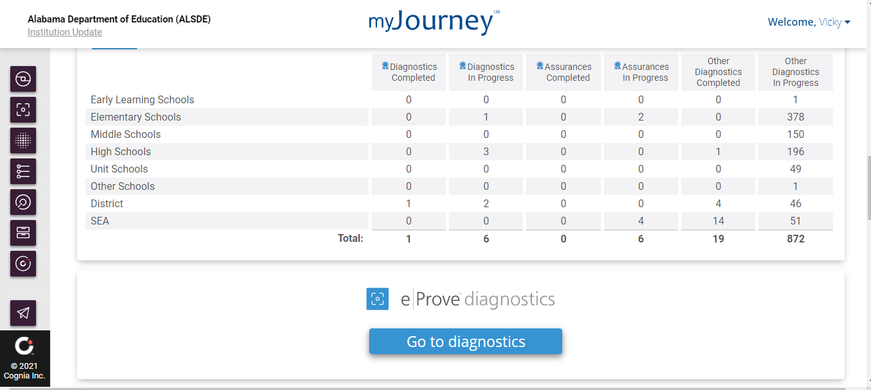
Accessing Diagnostics
Navigate to the eProve diagnostics widget and select Go to diagnostics.
Chose the
“diagnostics” module
Notes:
2. Navigate to eProve diagnostics widget and select Go to diagnostics.

Slide 11

Below is the exact name of the diagnostic administered by ALSDE.
Type | Content Name | Purpose
School / Non-LEA | 2022-2023 21st Century Community Learning Center School-Level Diagnostic | This platform is where 21st CCLC grantees at the School-Level will upload their documentation. The documentation must support the Indicators from the Federal Programs Compliance Monitoring document.

Slide 12
LEA admin can create and rename the diagnostics 2022-2023 21st Century Community Learning Center School-Level Diagnostic for the new school year
  Note: Please add your institution name as the end of the Diagnostic Name
LEA admin can add users and discuss the various roles available.
LEA admin can resend user invites if the acceptance links have expired/been lost

Slide 13
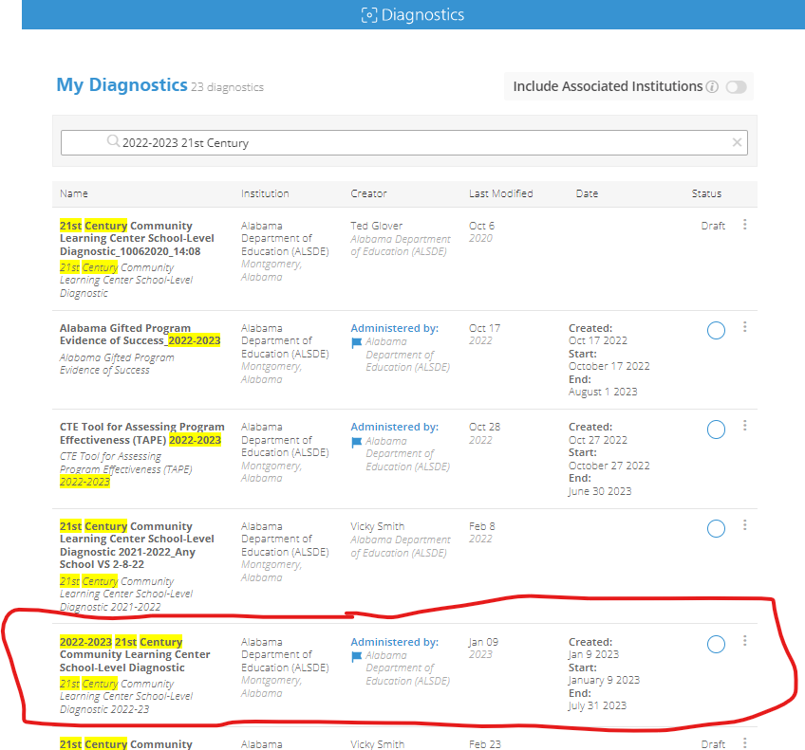
Starting a New Diagnostic
To start a diagnostic, locate the diagnostic in the My Diagnostics dashboard.
Notes:
3. After navigating to eProve diagnostics widget and selecting Go to diagnostics.
If your institution has a diagnostic assigned to it, you should see a flag denoting the
diagnostic on your eProve dashboard. Note that the administered diagnostic appears
on your institution’s dashboard only after the administration’s start date. Use the search option with the least number of words to locate the diagnostic.
In addition,
your institution’s HOI (Head of Institution) and PC (Primary Contact) receive
notifications that the diagnostic has been assigned.
To start a new custom diagnostic; go to the top right and click on New Diagnostic and when the drop-down window opens, chose the option browse the content library

Slide 14
Accessing a started diagnostic
If your institution has a diagnostic assigned to it, you should see a flag denoting the diagnostic on your eProve dashboard. Note that the administered diagnostic appears on your institution’s dashboard only after the administration’s start date.
Your institution’s HOI (Head of Institution) and PC (Primary Contact) receive notifications that the diagnostic has been assigned. Additional users/admins may be added in user management by the HOI or Cognia.
Select the vertical ellipsis (three dots) next to the diagnostic. Select Open Diagnostic from the drop-down menu.
Notes:
Before we cover how to complete a diagnostic, we want to learn how to access or go back to a started diagnostic. The user would login and when you have reached the My Diagnostic Dashboard, you may search or scroll down until you locate the correct diagnostic. If the diagnostic has been started, it cannot be deleted. It can only be deleted in draft format.
If your institution has a diagnostic assigned to it, you should see a flag denoting the diagnostic on your eProve dashboard. Note that the administered diagnostic appears on your institution’s dashboard only after the administration’s start date. In addition, your institution’s HOI (Head of Institution) and PC (Primary Contact) receive notifications that the diagnostic has been assigned.
A began and end date may be set by ALSDE.
If need help is needed with account, contact client care
Select the vertical ellipsis (three dots) next to the diagnostic.
Select Open Diagnostic from the drop-down menu.
End section #5

Slide 15
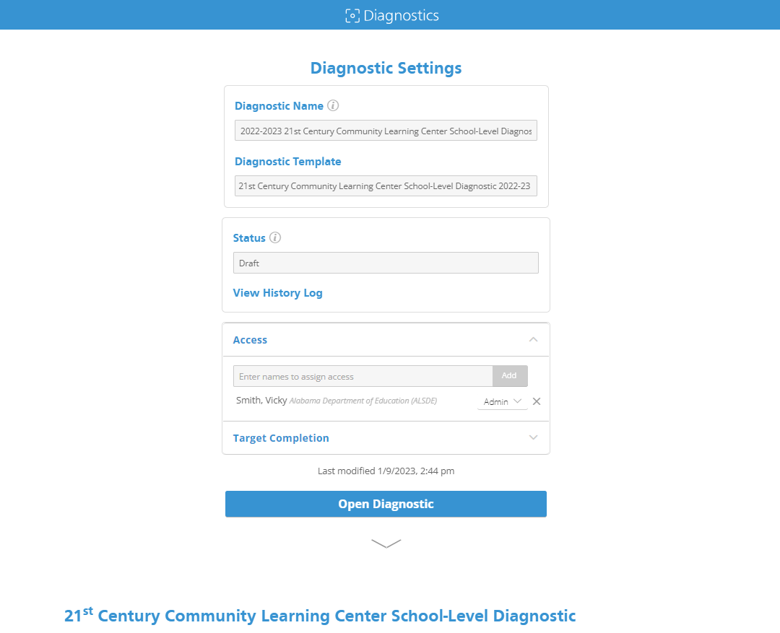
Diagnostic template my be edited. Add your institution name at the end.
Open diagnostic to respond to items
Notes:
The administrator in the district has the ability to rename the Diagnostic Template. Please rename based on directions from ALSDE. Please add the exact name of the institution from which the grant was awarded.

Slide 16
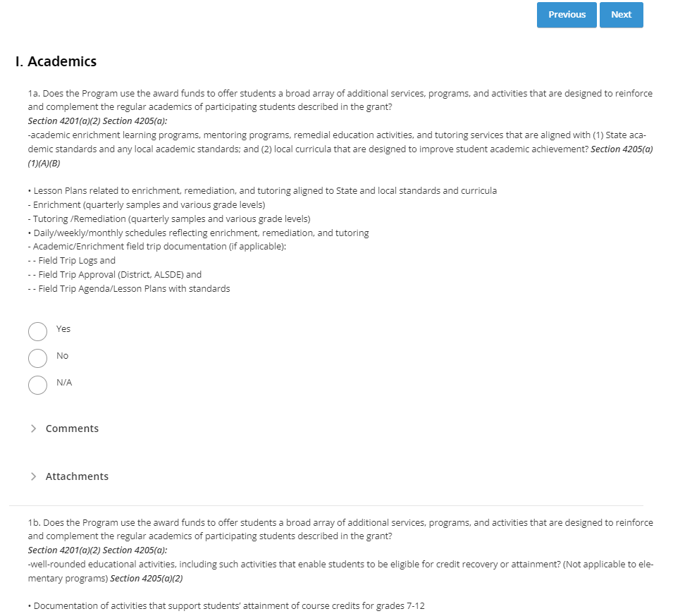
Complete the diagnostic
Notes:
The assurances are numbered within these sections starting with number 1a.
Here are some of the things you’ll see, as you complete the diagnostic:
Matrix type questions save you time, because you can answer assurances quickly
Assurances are grouped by 15 program areas
You can attach evidence and provide comments inline—right with the assurance and track your completion.
You’ll see change logs that give you a snapshot of a point in time, and you can
Download your completed diagnostic in PDF and CSV format, and then
Send it to Workspace, for the team to review

Slide 17
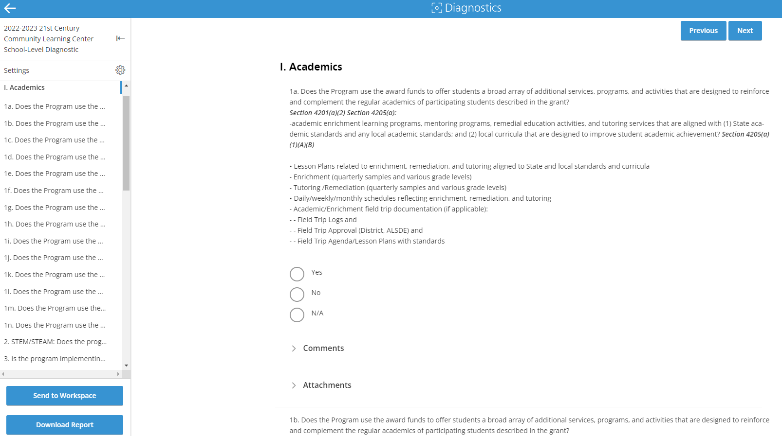
Respond to Assurances
Short cut menu
Notes:
This screen shows a matrix diagnostic with Yes, No, and Not Applicable responses for each of the assurances within the diagnostic. Remember you need to unlock the diagnostic in order to respond.
Use the left-hand menu to navigate between sections in the diagnostic.
Note that questions may require comments and attachments, which you provide right there inline. To add a comment to a diagnostic question, select Comment. Add your comment in the box that appears below the drop-down.

Slide 18
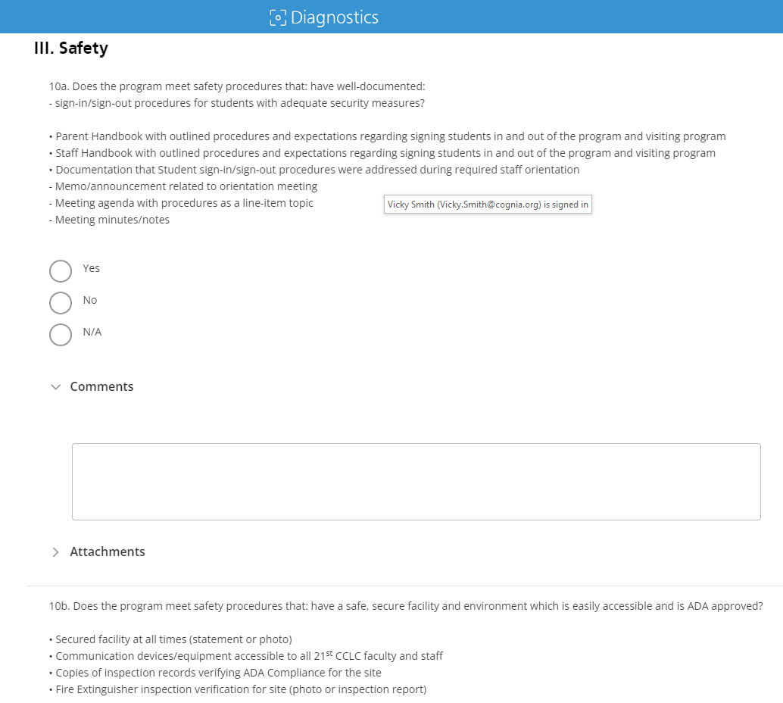
Respond to value questions
Notes:
Some questions in the diagnostic are “value response needed.” Value questions instruct you to answer N/A and enter the answer to the question (value needed) in the comment field.

Slide 19
Uploading attachments

Slide 20
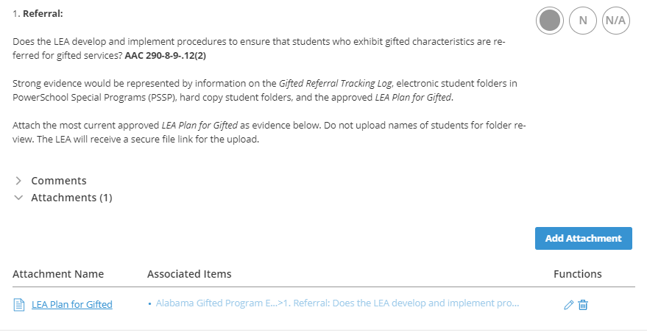
Adding an Attachment
Notes:
To attach files or relevant links to your diagnostic questions, select Attachments below the question.

Slide 21
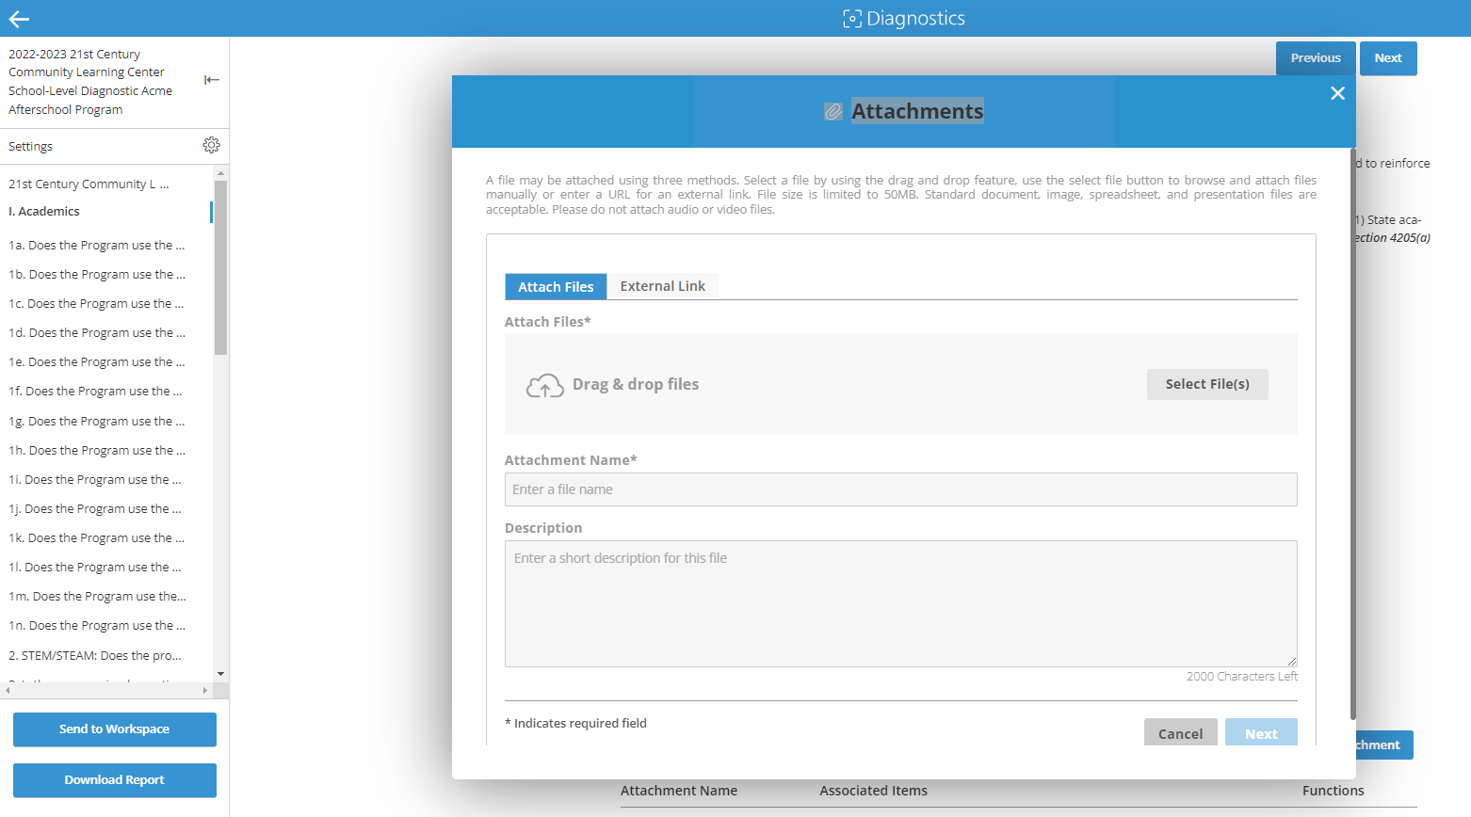
Upload and attach evidence/links
Notes:
To attach files or relevant links to your diagnostic questions, select Attachments below the question.
The Attachments dialog box contains two tabs: one for attaching a file up to 10 MB, and the other for adding relevant links.
Upload an attachment or add a link, and then select “Add Items” to connect the attachment or link to the relevant part of the diagnostic.
The Attachment Name is required, and the Description is optional.
When you have finished uploading the attachment, select Next.

Slide 22
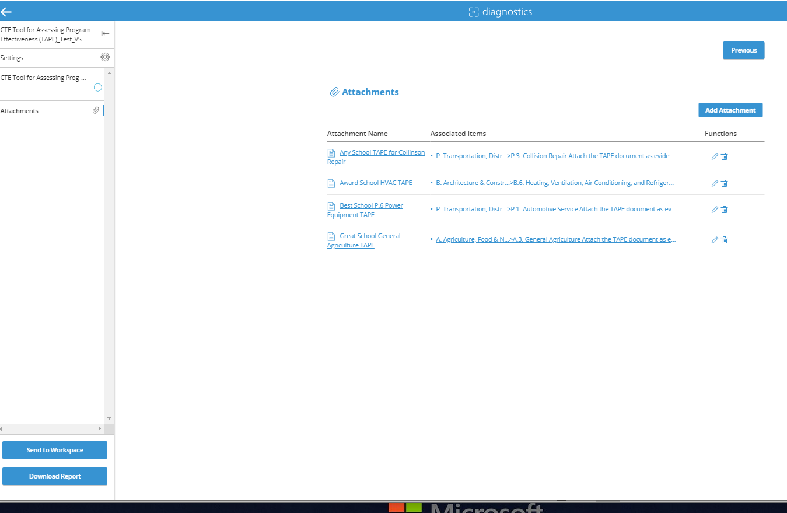

View All Attachments
Notes:
After you link an attachment to an item, that attachment appears on-screen in the diagnostic, under the related question and demonstrated here at the end of the diagnostic.
To view all the attachments, including those that are not associated to specific questions in the diagnostic, select Attachments from the left-side menu in the diagnostic, or scroll down to the bottom of the diagnostic.
You can also add attachments to the diagnostic from this page, or edit or delete an attachment.

Slide 23
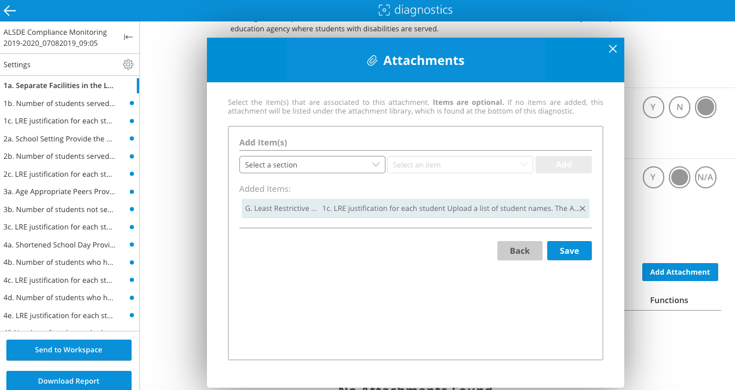
Associate evidence with questions
Notes:
To associate an attachment to a specific question in the diagnostic, select the question in the first drop-down menu under Add items. Next, select the attachment you want to associate to that question, and select Add. The items you just associated to each other appear under Added items.
If you add an attachment, but do not connect it to a specific item in the diagnostic, the attachment appears at the bottom of the diagnostic.
End of section

Slide 24
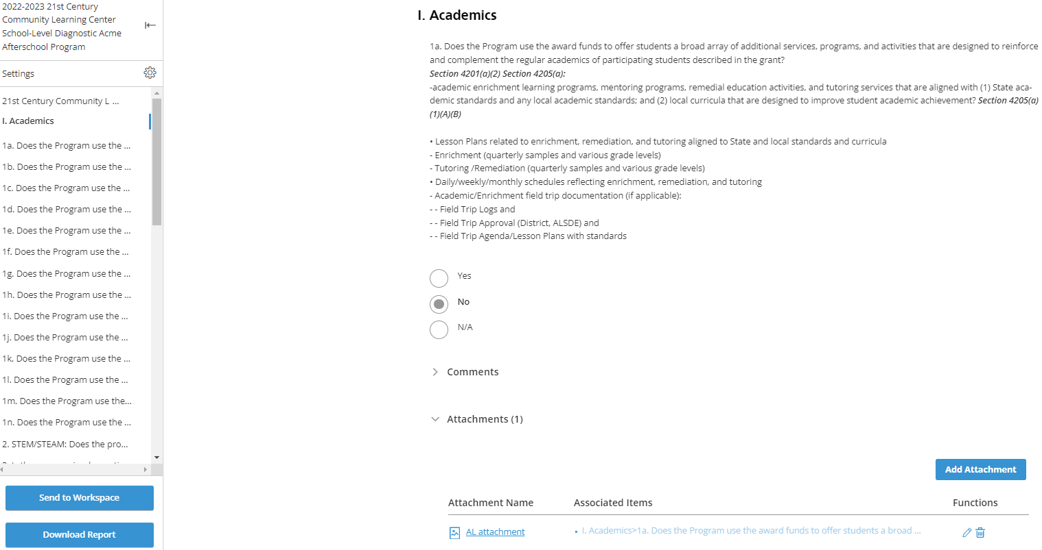
Review question and attachments
Notes:
After you link an attachment to an item, that attachment appears on-screen in the diagnostic, under the related question.
To edit or delete the attachment, select the pencil for edit, or the trashcan for delete.

Slide 25
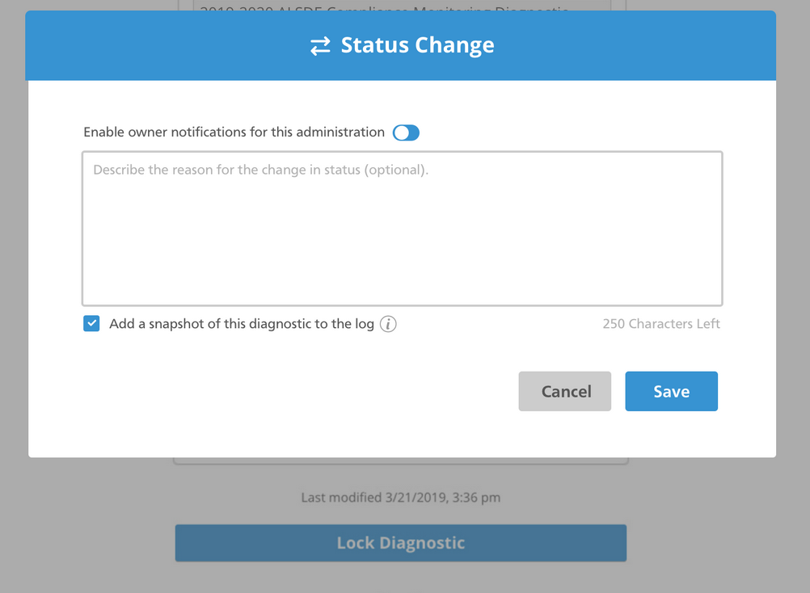
Lock and unlock diagnostic
Notes:
To change the status of the diagnostic – for example, from Unlocked to Locked – scroll up to the Settings screen and change the status in the Diagnostic Settings. The Status Change dialog box will pop up.
If you want to notify the ALSDE of the status change, select the toggle next to “Enable owner notifications for this administration.” You may also choose to add a reason for the status change or add a snapshot of the diagnostic to the log for your own personal records. This is recommended in the event there is ever a need to obtain and/or restore data from earlier in the diagnostic answers process. When you have finished, select Save to return to the Settings screen.

Slide 26
Lock and unlock diagnostic
To change the status of the diagnostic – for example, from Unlocked to Locked – scroll up to the Settings screen and change the status in the Diagnostic Settings. The Status Change dialog box will pop up.
To notify the ALSDE of the status change, select the toggle next to “Enable owner notifications for this administration.”
To add a reason for the status change or add a snapshot of the diagnostic to the log for your own personal records
When you have finished, select Save to return to the Settings screen.
Notes:
To change the status of the diagnostic – for example, from Unlocked to Locked – scroll up to the Settings screen and change the status in the Diagnostic Settings. The Status Change dialog box will pop up.
If you want to notify the ALSDE of the status change, select the toggle next to “Enable owner notifications for this administration.” You may also choose to add a reason for the status change or add a snapshot of the diagnostic to the log for your own personal records. This is recommended in the event there is ever a need to obtain and/or restore data from earlier in the diagnostic answers process. When you have finished, select Save to return to the Settings screen.

Slide 27
Managing Users in Diagnostics for
Institutions
Notes:
Now, let’s take a quick look at Diagnostics.
You and your team are the experts about your school and system. Our standards guide you to identify areas of strength and opportunities to elevate the quality of your school.
Diagnostics

Slide 28
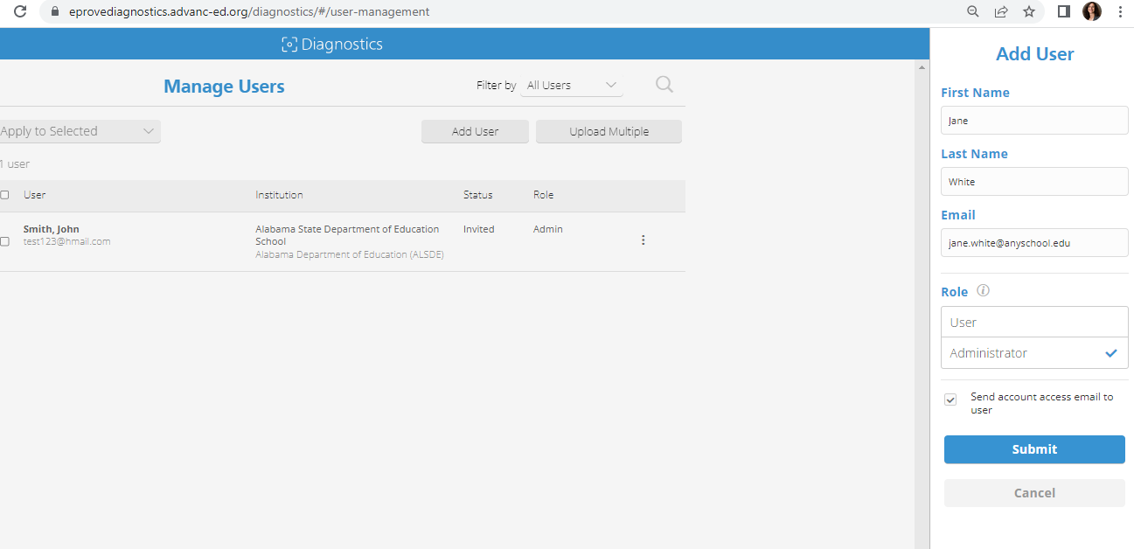

Managing users within diagnostics
Adding a single new user
1. Select Add User.
2. Enter the user’s first name, last name, and email address.
3. Select the user’s role: User or Administrator.
4. To send an invitation to the user by email, select the Send Account access email to user checkbox.
5. Select Submit.

Slide 29
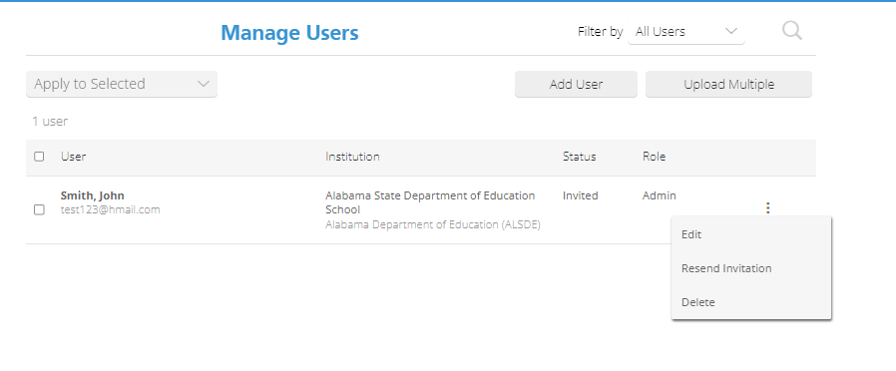
Managing an Existing User
1. Locate the user you want to manage. To search for a user, type the user’s name or email into the Search field. Names or emails that match the Search criteria are highlighted below the field.
2. Select the vertical ellipsis to the right of the user you want to manage. The pop-up menu contains the following options for all users:
  • Edit – allows you to change the first name, last name or role of the selected user
  • Resend Invite – resends the invitation email to the user
  • Disable – allows you to remove access for an enabled user who has content in the account (that is, the user has started or responded to a diagnostic) without disrupting the content. Disabled usernames remain in the Manage Users list; you can enable them at a later date, if needed.
  • Delete – removes invited users or enabled users who do not have any content in the account. Delete completely removes the user from the list.

Slide 30
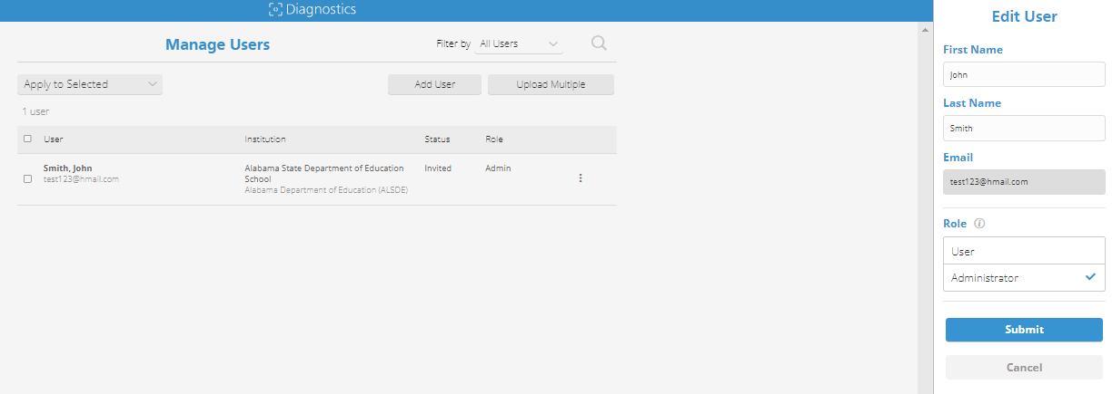
Managing an Existing User
3. Select Edit to update the information for the user (first name, last name, role). Note: You cannot change a user’s email. To use a different email, create a new user.
4. When you have finished, select Submit.

Slide 31
Sending Diagnostics for
Institutions to Workspace

Slide 32
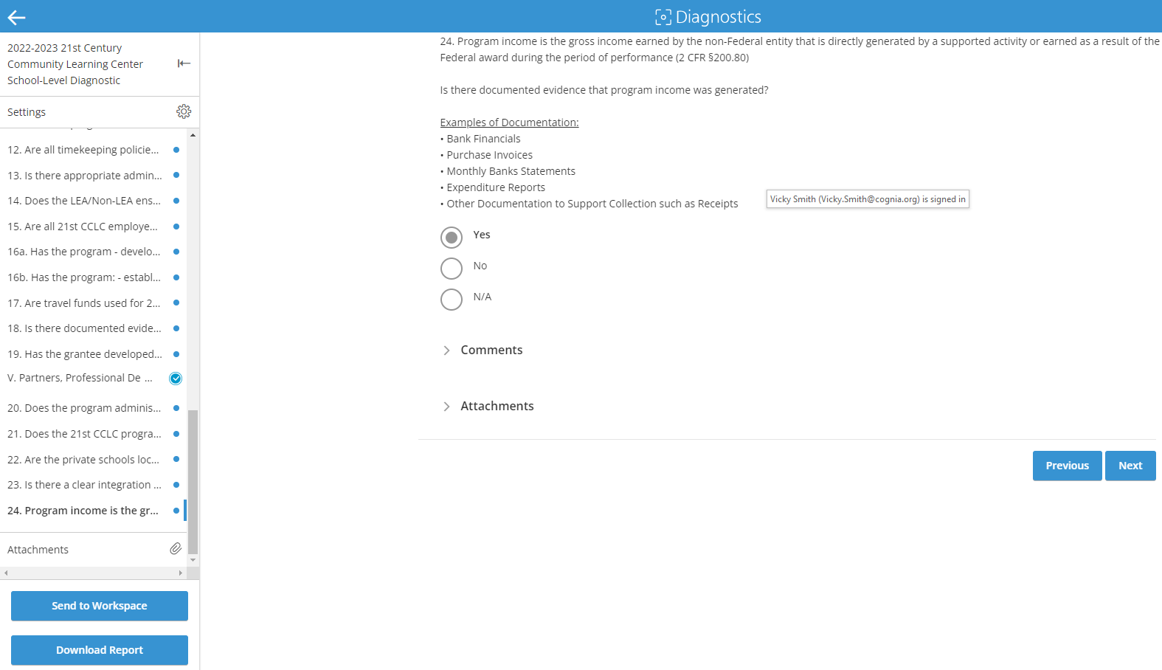
Send completed diagnostic to Workspace
Notes:
When your institution has finished with the diagnostic, select Send to Workspace. This will send your completed diagnostic, with all uploaded comments and attachments, to your selected workspace review. Select the workspace for your review team to receive your self assessment.
Send to Workspace also automatically notifies the administration owner (DOE) and the team leads that you have sent the diagnostic.
Institutions upload their completed diagnostics to the shared workspace

Slide 33
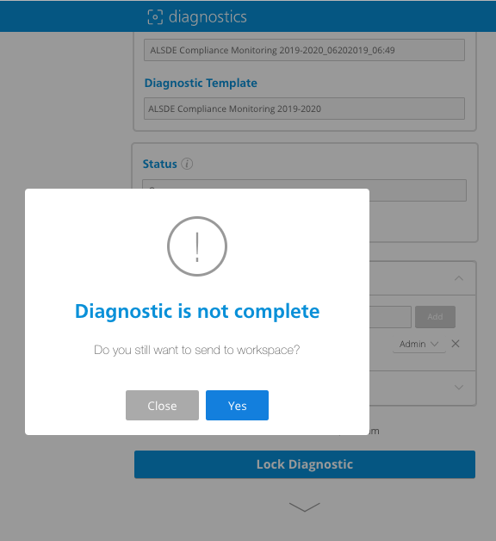
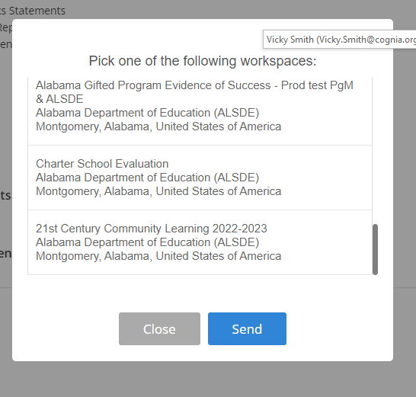
Watch for possible prompts
Notes:
If you select Send to Workspace and ‘Diagnostic is not complete’ appears, select close and go back to address areas that have not been answered in the diagnostic.
If you select Send to Workspace and a “Review Not Found” error appears, it means that your workspace might not yet be assigned to a review. Once you have a review assigned, you can send the attachments to the workspace review.
HOI must accept the invite for the workspace to show up in the dropdown menu. If you are not the site coordinator, please contact the site coordinator for assistance or contact Cognia’s client care to update the HOI for the site.
This completes the diagnostic for the institution in Cognia’s diagnostics module. All future actions take place in workspace.
END section

Slide 34
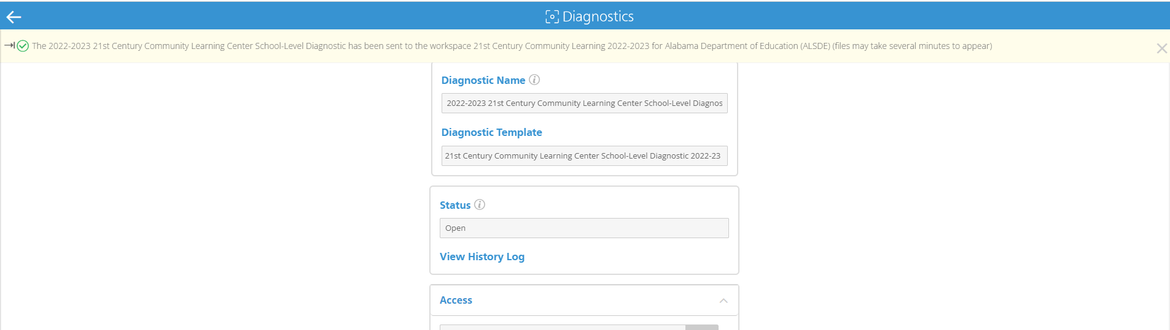
Verification Statement
Notes:
Once submitted the user will see on the screen a confirmation that the responses, comments and attachments were successfully sent to the workspace.

Slide 35
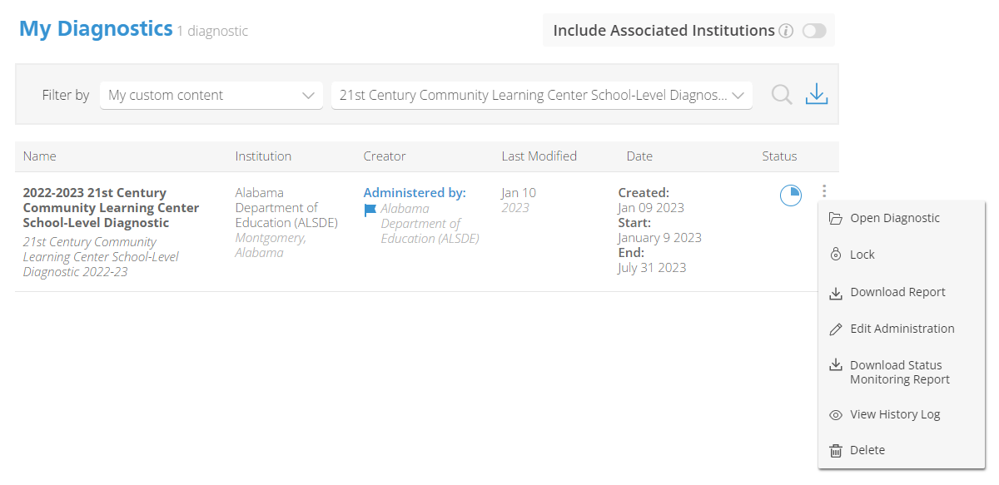
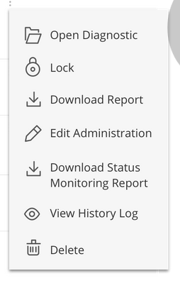
Download completed report
Notes:
START section
reports available include: PDF and CSV reports of the diagnostic and the status monitoring report. To download reports, navigate to your diagnostics dashboard.
Select the ellipsis next to the diagnostic.
For Diagnostic Content reports, select Download Report from the drop-down menu. You can download these reports in CSV format and import it into a spreadsheet, or you can select PDF format for a printable report.
For Status Monitoring reports, select Download Status Monitoring Report from the menu. Status Monitoring reports are generated in CSV format only.
Select Download.
Note this slide reflects an open diagnostic. Closed diagnostic will show View Diagnostic, Download Report and View History Log
If you have downloaded a PDF report, choose Open or Save As from the Acrobat dialog. For reports in CSV format, choose Open or Save As from the Open Raw Data dialog box.

Slide 36
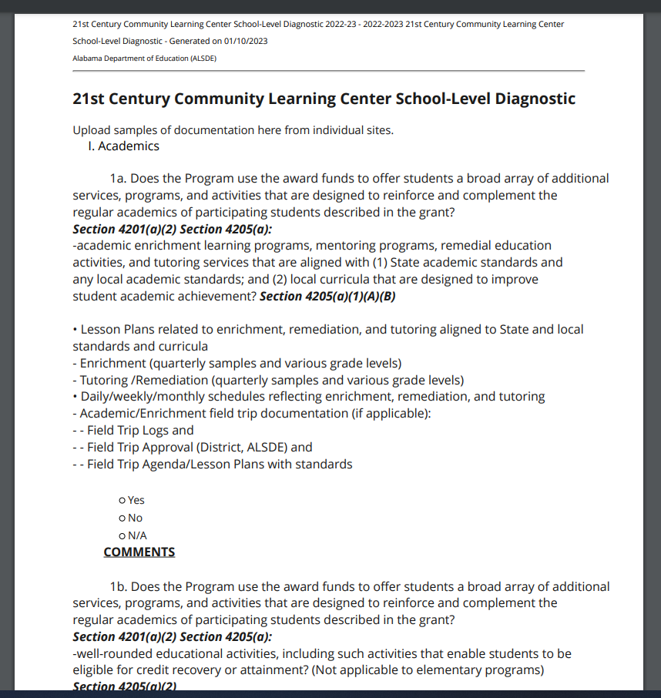
Sample PDF report
Notes:
Here’s a sample PDF report. The attachments that are assigned to specific questions in the diagnostic appear below the associated questions.
All of the attachments, even those that are not associated to specific questions, appear in a table at the end of the report. Embedded links are live in the PDF". Attachments are not active.
An attachment Summary is also included in the PDF

Slide 37
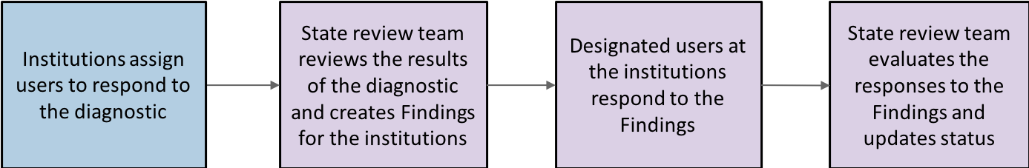
Transition to Workspace
Institution tasks:
Send completed diagnostics to the workspace
Identify contributors to correspond with the review team
Locate the diagnostic in Cognia’s Platform in the workspace module
Respond to review findings
Add notes and attachments to the responses
Notes:
Once you’ve completed your diagnostic, this slide shows you the transition you’ll make, from working in the eProve diagnostics application program, to working in the eProve workspace application program.
eProve workspace serves as the central communication area between districts and ALSDE.
Here, you see the basic steps in the Compliance Monitoring workflow. We’ll go into each of the institution-specific tasks in detail later on. The tasks that take place within eProve diagnostics are highlighted here in the workflow in blue. The tasks that are performed within eProve workspace are shown in purple.
READ THE CONTENT ON THE SLIDE

Slide 38

Workspace
Notes:
Let’s take a brief look at Workspace

Slide 39
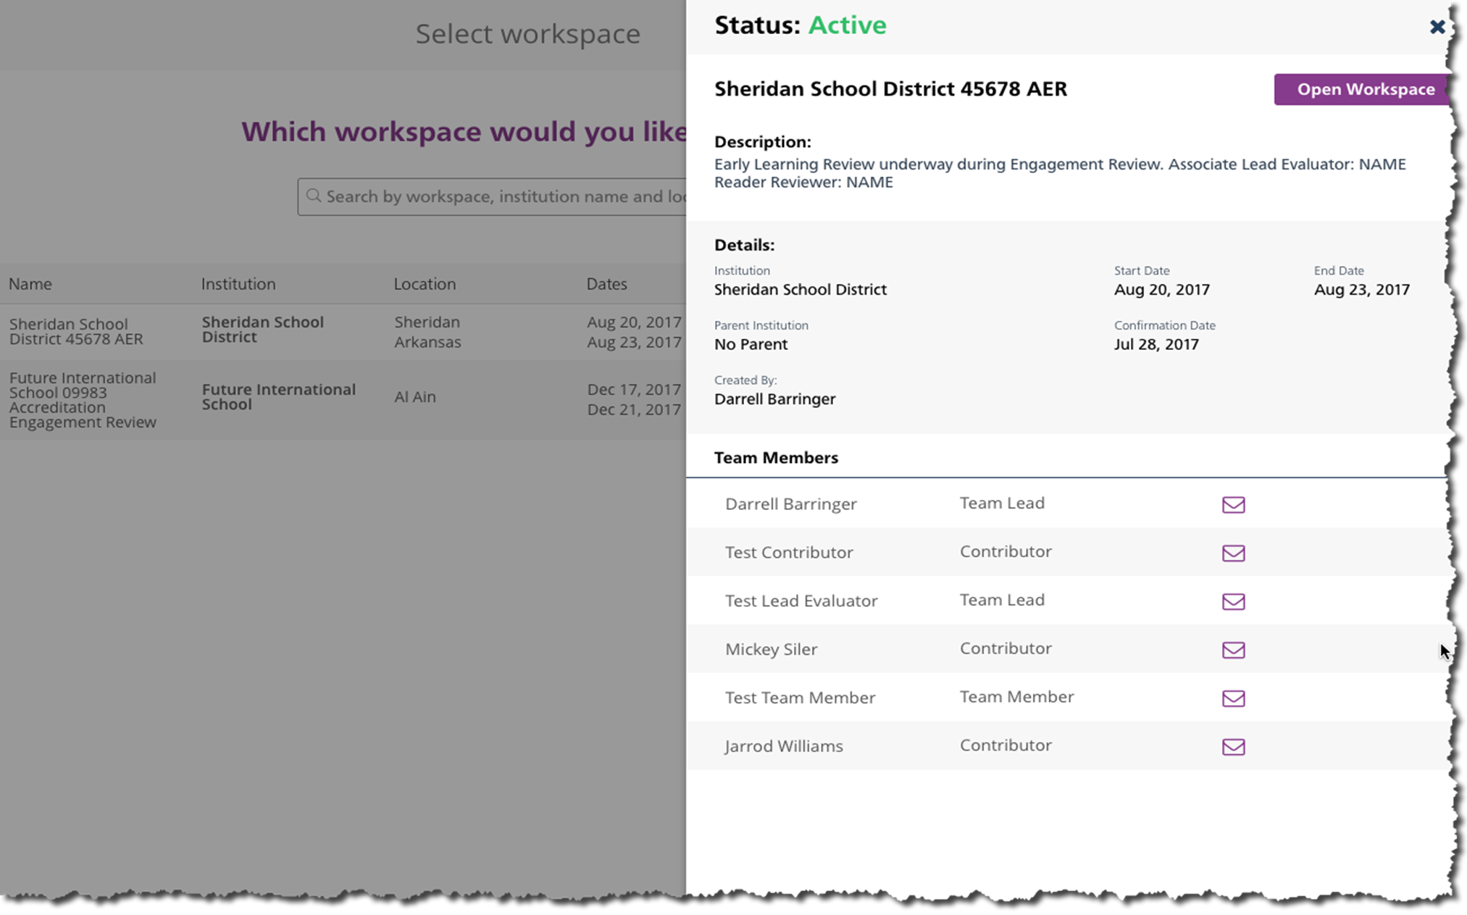
Workspace
Notes:
Workspace is used as a tool to share information between institutions and certification or accreditation / monitoring of programs by review teams. When reviews of any type require the school or system to submit evidence toward standards, a workspace will be assigned as needed. Folders are created for shared access for all users and separate folders for review team member access.
Workspace is your digital filing cabinet to submit evidence you want to share with the review team. Currently, the workspace is only available during the year that an engagement review is conducted.

Slide 40
Workspaces are created on 2-8-23 and 2-9-23
Must accept the invite within 24-48 hours
Head of Institution (Site Coordinators) will receive an automated email invitation.

Slide 41
Locate the Corrective Action Plan or findings in workspace following either a site visit or once ALSDE has reviewed your responses and evidence from the diagnostic.
If a Finding is created the HOI within the workspace will receive a notification email.
Respond to findings in Workspace

Slide 42
Workspace
Locating Findings after a ALSDE has reviewed your diagnostic and discussed with the institution.

Slide 43
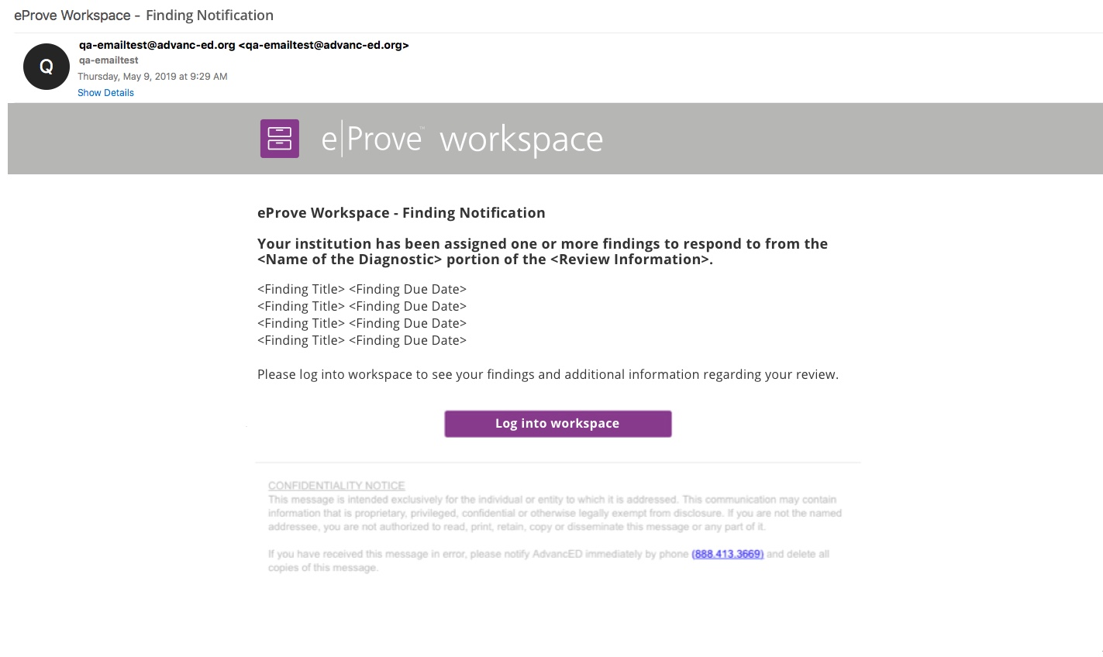
Notification to the district
Notes:
There is an initial notification sent to the district containing Findings information per program area. This notice is sent when the individual review diagnostic is marked complete with at least one Finding. The principal or site director the users within the school who are classified as the contributor receive the notifications.
The findings may also be accessed by logging into the workspace module.

Slide 44
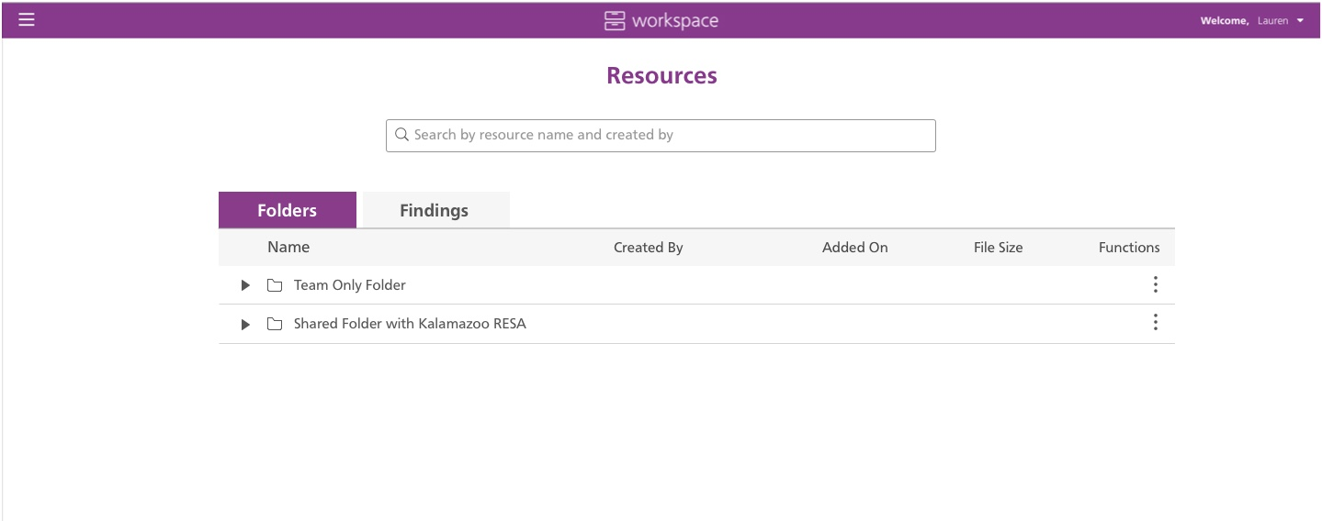
Manage resources
Notes:
Using the left navigation, review teams at ALSDE may navigate between the responses from the schools/institutions Activities and Manage Resources.
Under the Manage Resources, the review team leads and team members will be able to see both Team Only Folder and Shared Folder with the District.
Contributors from the school/site will only be able to add to their shared folder. Schools/sites are encouraged to use Findings notes to communicate and add attachments for the ALSDE review team. Additional materials to support the improvement process pre- or post review should be added here.

Slide 45
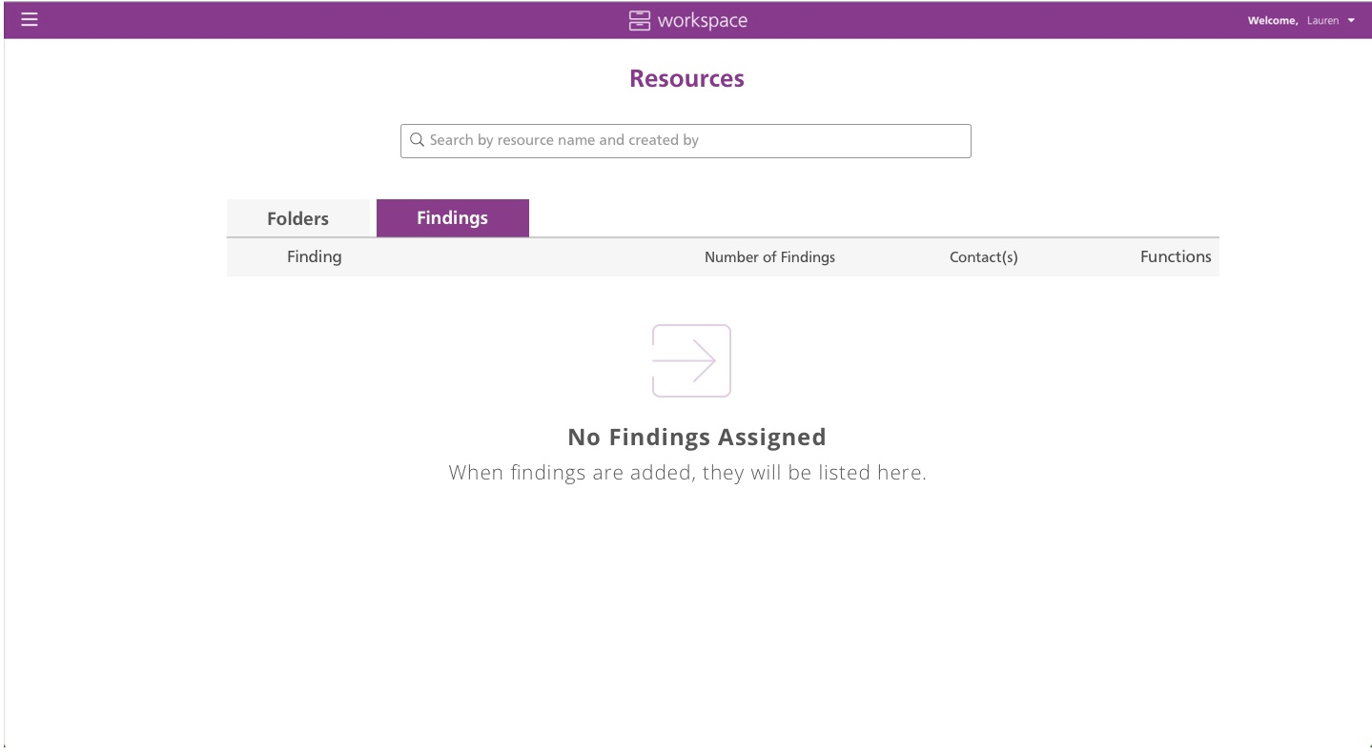

Use findings
Notes:
The Findings tab is not available to the ALSDE review team or institution until a Finding is created.

Slide 46
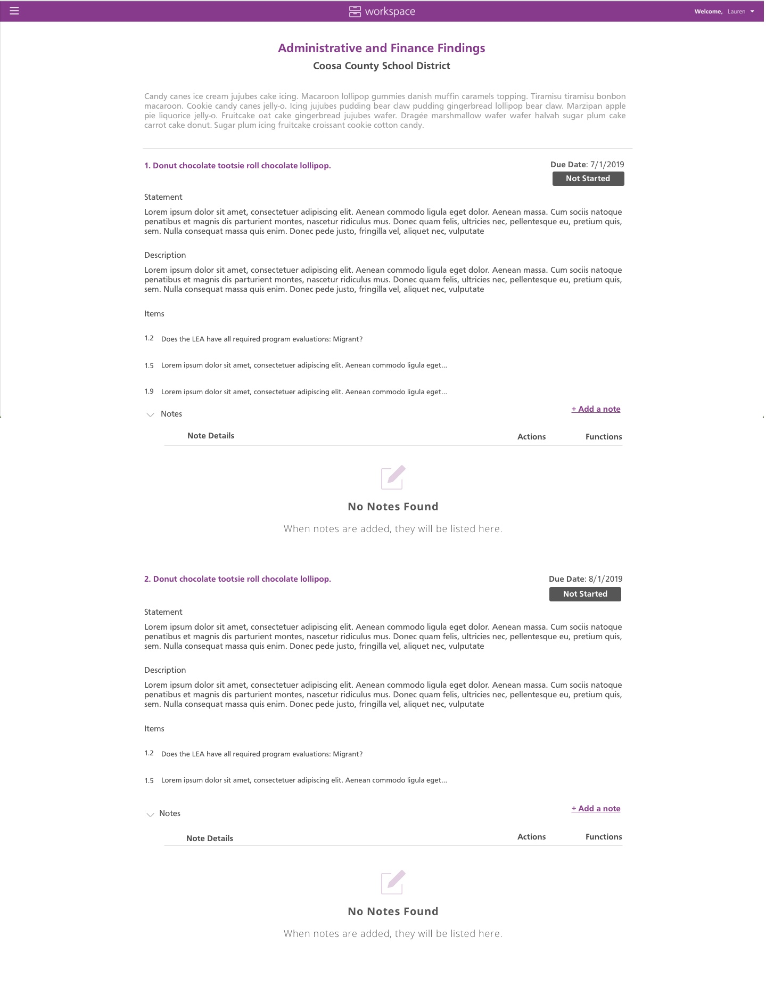
Review findings
Notes:
Here we see a sample of a Findings that has not yet been responded to. To change the status of the findings, select the 'add a note' link.
A pop up will allow a response to be given by the site / school or ALSDE Review Team and will have an action dropdown with the options of Accept and Reject for the team, and Plan Created, Implemented, Work In Progress and Will Not Implement for the Institution.
The actions in the drop down are optional.

Slide 47
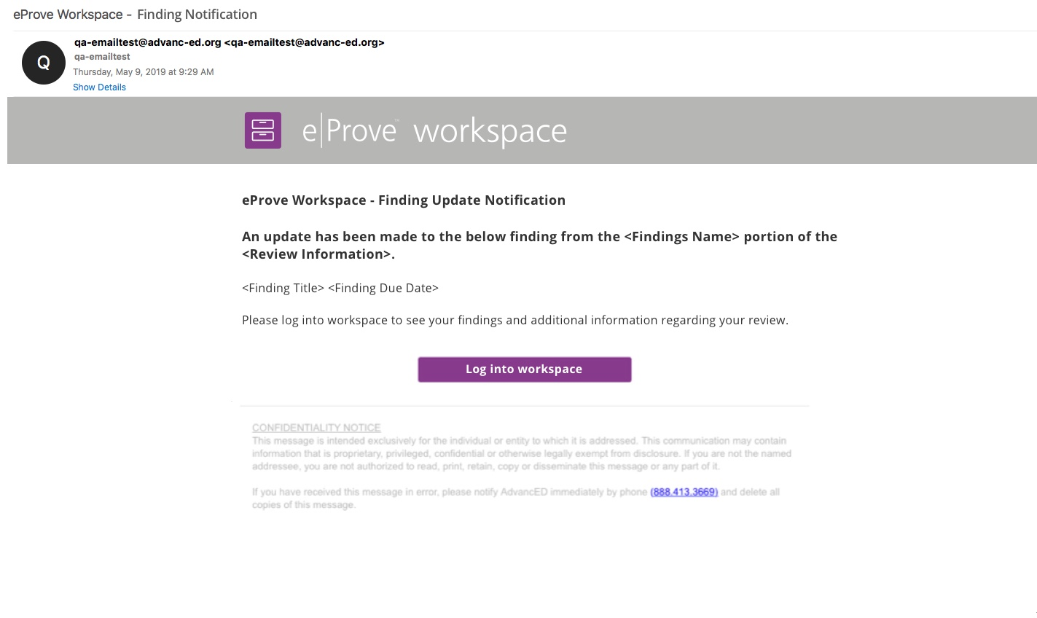
Notification for review findings updates
Notes:
Subsequent notifications within the review diagnostic program area are sent as updates are made between site/school and ALSDE review team.

Slide 48
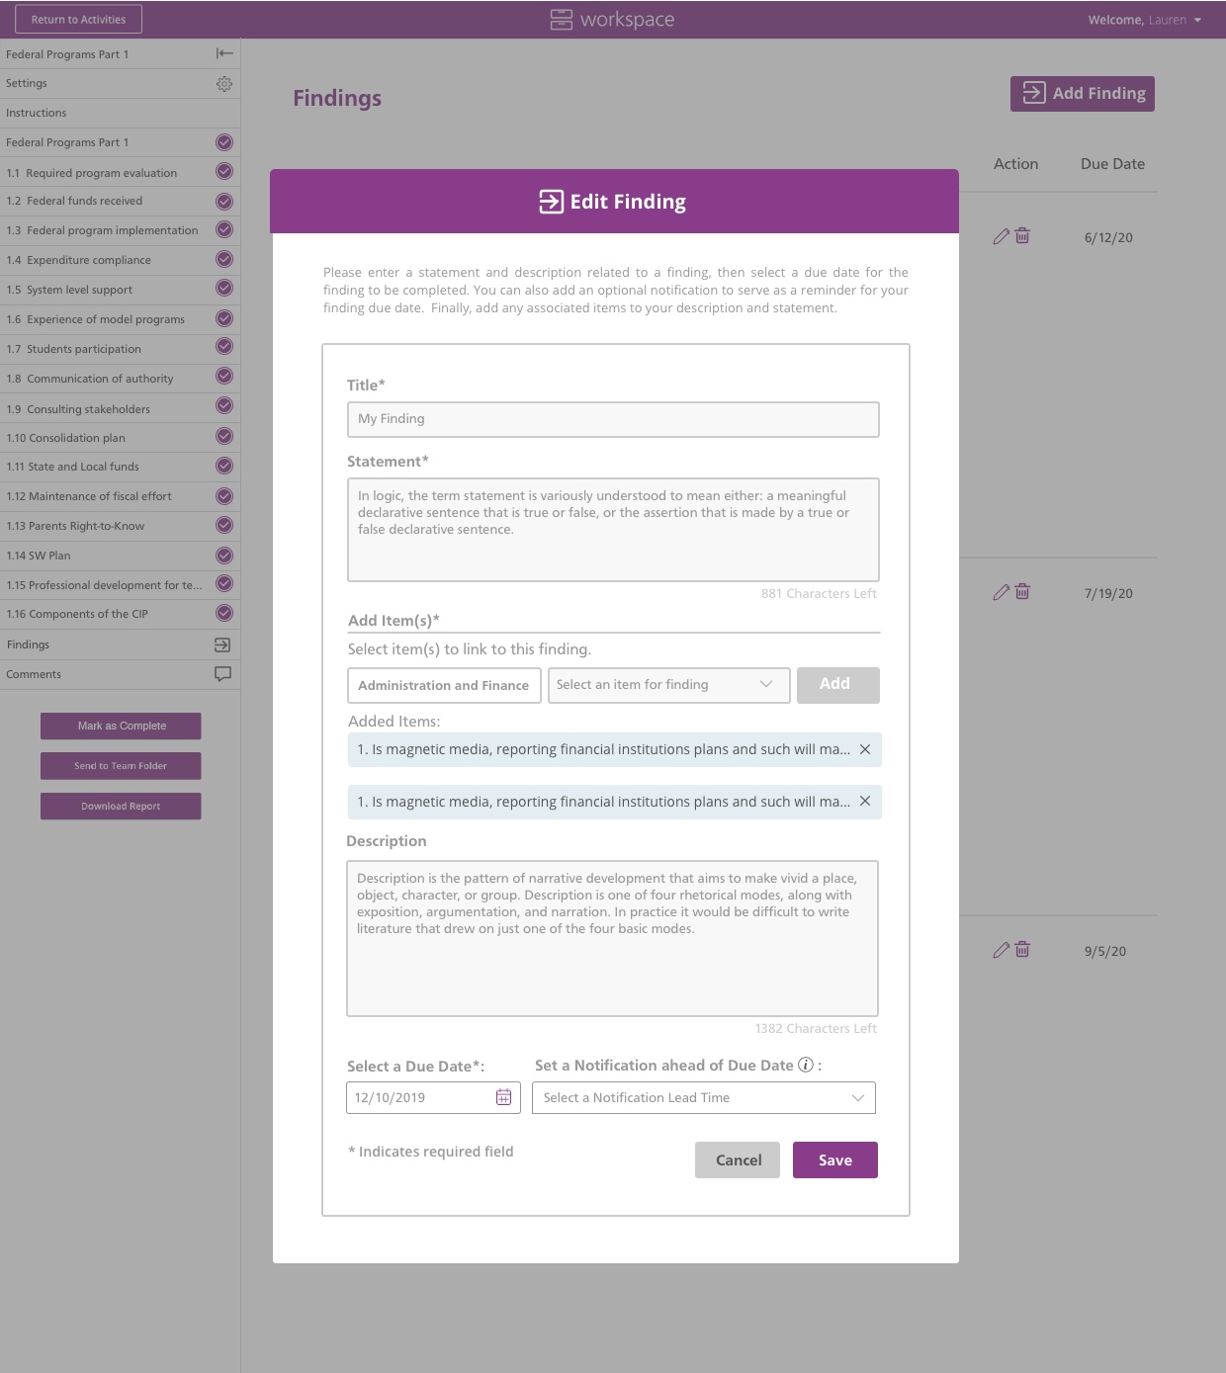
Edit findings
Notes:
When a review team member selects Add Note, this window appears. At the top left corner of the window is a drop-down menu that changes the status of the review item.
The review team can review district notes with attachments and send new due dates as a note.
When the team member is finished adding a note, they select Save. The note appears under the corresponding item of the diagnostic action plan.
Notes enable the review team to correspond with the district continuously within workspace.

Slide 49
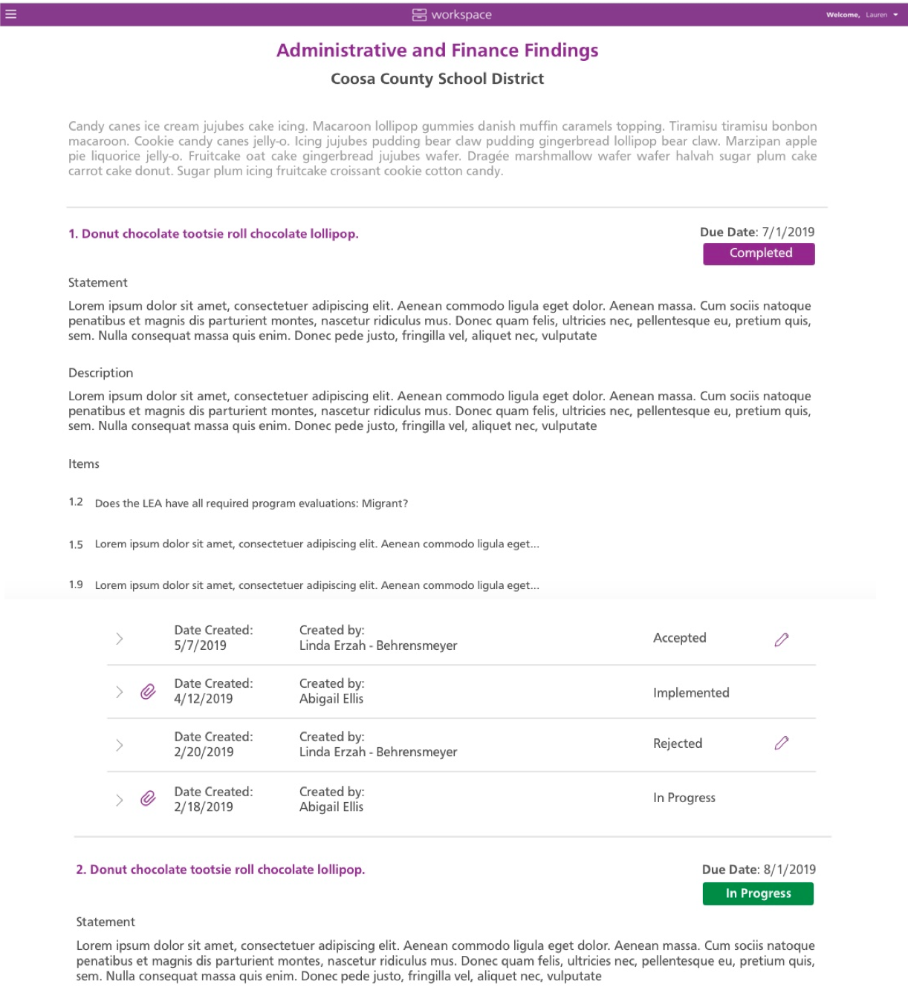
Communicate findings
Notes:
Here we see the diagnostic Findings with notes between the review team and site/school. This is an example of a diagnostic with Findings in various stages; i.e. accepted or in progress.

Slide 50
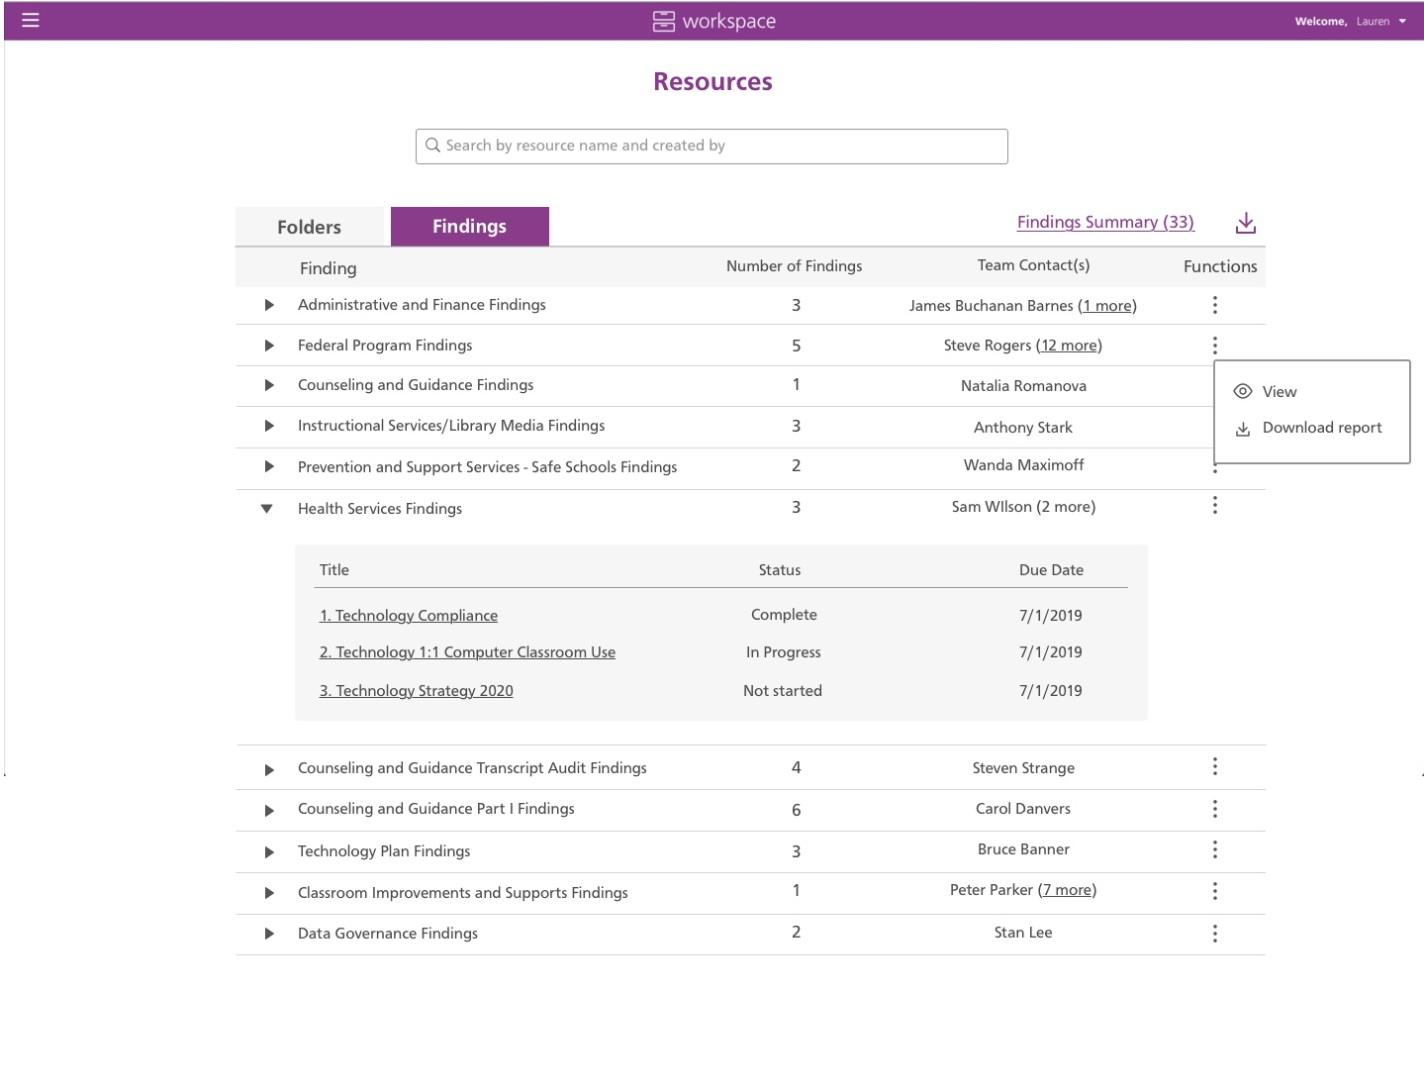
Monitor findings
Notes:
When the review team creates a Finding, the site/school’s contributors (normally the Head of Institution and Primary Contact) receive an email notification containing the title of the Findings and the related due dates. The email will also alert sites/schools that they can access the shared workspace to see the complete action item.
To respond to the Findings, log in to eProve workspace.
Select Manage Resources from the menu.
Select the Findings tab.
To view a specific Finding, select the arrow to the left of Findings tab. Then select the correct diagnostic titled Findings to address.
END VIDEO VIGNETTE #11

Slide 51
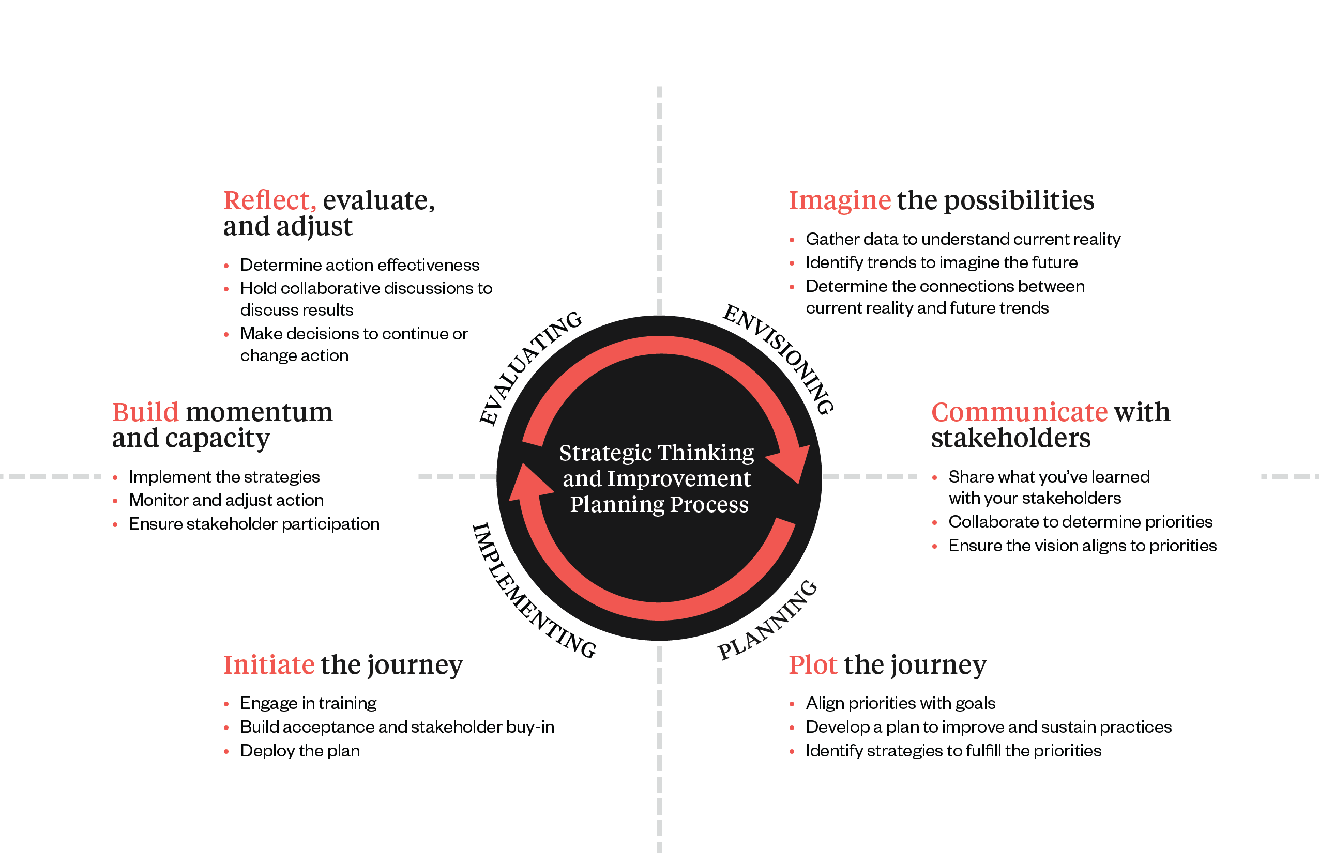
Data-Driven Continuous Improvement System
It Takes a Village
Notes:
What we just discussed is how to drive school improvements to achieve improvements in student performance. This is the ultimate goal of the continuous improvement process. This graphic shows the Cognia Continuous Improvement System. Today, we will delve into how data can be used to drive this continuous improvement journey.
Success and effectiveness of a school cannot be a one-time check for completion. At Cognia, we use the word “system” because many parts must work together in continuous motion. Think of organ systems in the human body, water filtration systems, etc. Each part in a system has a role and, at each stage of functioning, something must be done before going to the next phase successfully. The same is true for Cognia’s Continuous Improvement System.
The Cognia Continuous Improvement System is a comprehensive improvement solution that provides a framework, structure, tools, services, and resources to engage institutions in successful continuous improvement. It empowers and motivates institutions to engage in acts of Envisioning, Planning, Implementing, and Evaluating.
It provides structure for institutions to imagine the possibilities, communicate with stakeholders, plot and initiate the plan, build capacity and reflect, evaluate, and adjust.
In the middle, you will see the Strategic Thinking and Improvement Planning Process – envisioning, planning, implementing, and evaluating. These phases coincide with the continuous improvement system and the Cognia tools.

Slide 52
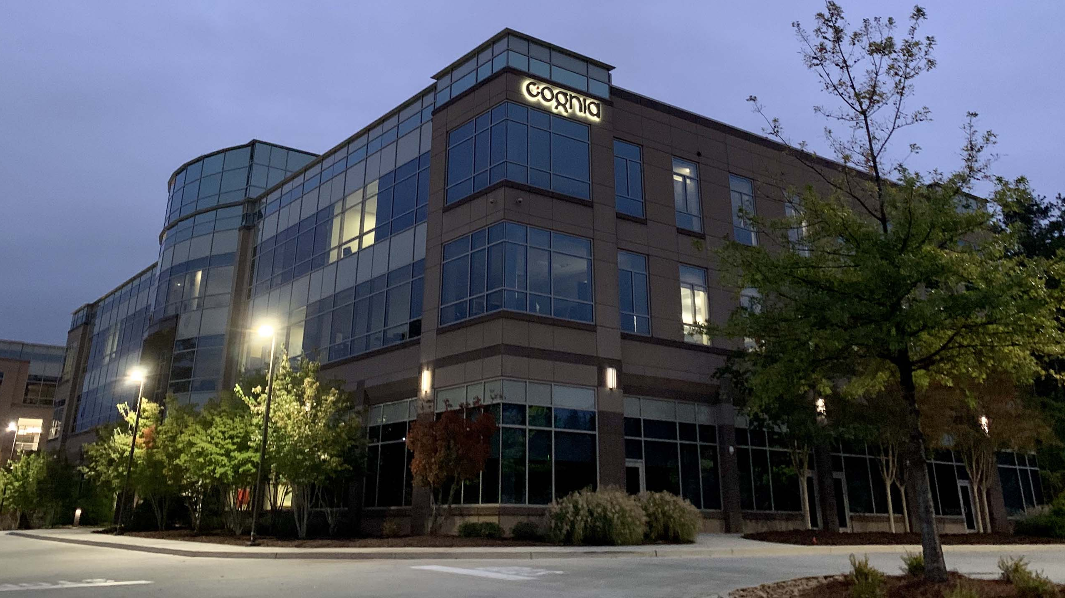






Questions?
Learn more at Cognia.org
Notes:
Please contact us if you have further questions.

Slide 53
Cognia Client Care clientcare@cognia.org
Vicky Smith
Vicky.Smith@cognia.org
Jeff Wooten
Jeff.Wooten@cognia.org

Slide 54
Link to Partnership Website https://alsde.onlinehelp.cognia.org

